Slide 1
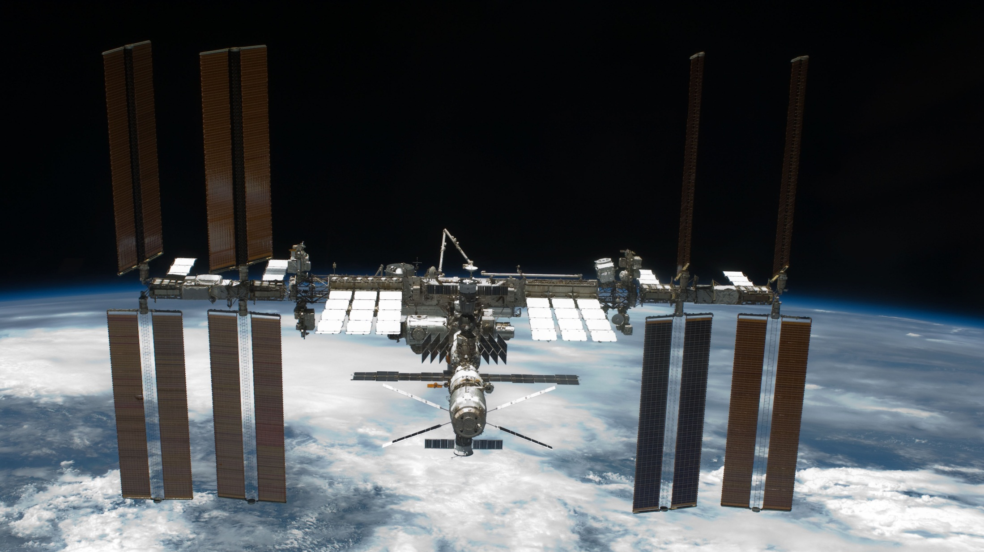
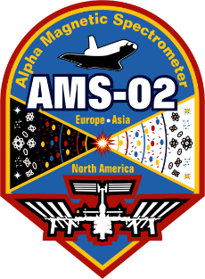
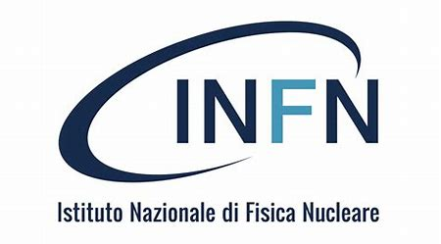
The Alpha Magnetic Spectrometer on the International Space Station
Near Earth Orbit:
altitude 400 Km
period 92 min
speed 28 800 km/h
AMS mission duration:
Entire ISS lifetime (up to 2028-2030)
AMS
AMS-02 webpage:
https://ams02.space
Notes:
Picture 6: Cosmic ray impinging AMS versus Cosmic rays impinging the atmosphere
Atmosphere is equivalent to the same amount of material as 4 meters of concrete

Slide 2
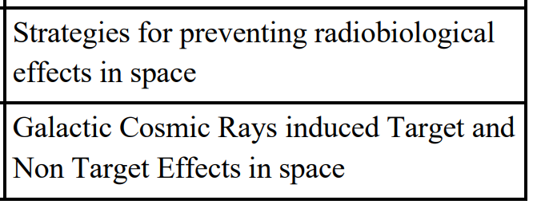
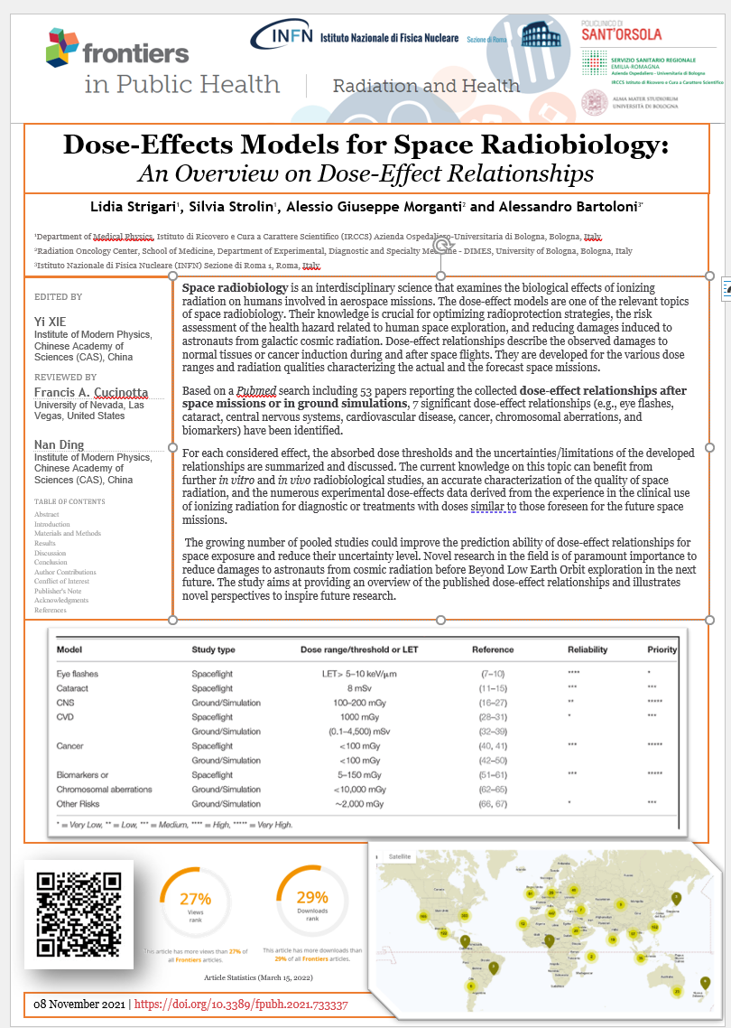
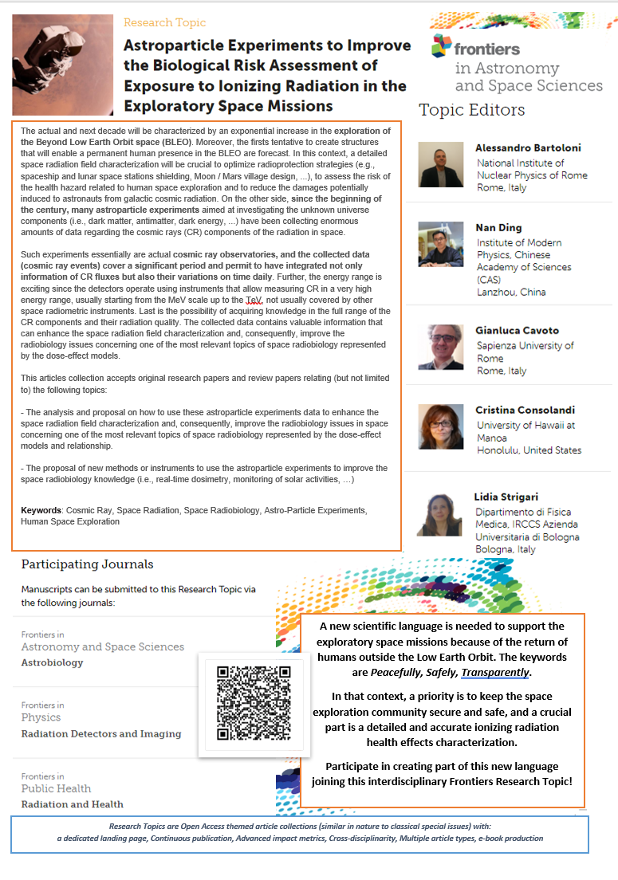
INFN Roma AMS-02 wiki:
https://wiki.infn.it/strutture/roma1/experiments/ams2/home
Available Thesis
At INFN Roma AMS group, led by Alessandro Bartoloni, the primary activity is the use of the AMS measurements of cosmic rays to improve the space radiobiology knowledge with a primary emphasis on the
space radiation relevance and risk for human space exploration.
In this topic, there is a strong collaboration and participation to the Roma group of the Medical Physics department of the IRCCS University Hospital of Bologna, led by Lidia Strigari.

Slide 3
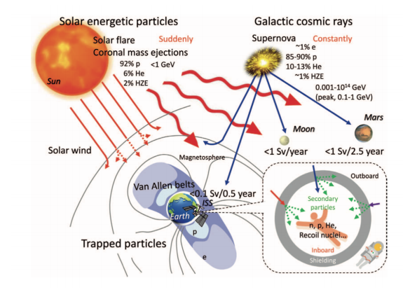
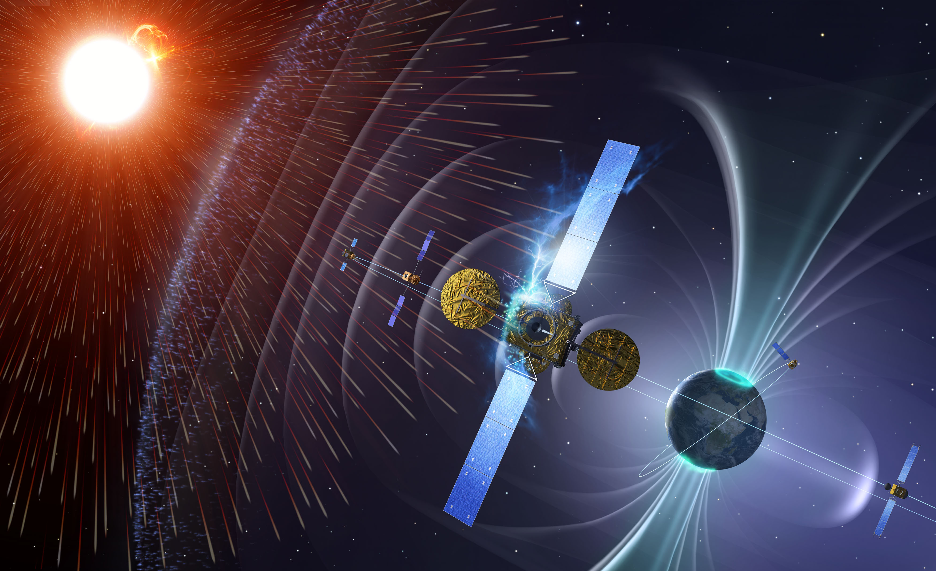
Space Radiation Environment
Human Space activities must cope with the high radiation environment of outer space.
Space Radiation composition
- Galactic Cosmic Rays (GCR)
- Particle emitted by the Sun (SEP) during isolated events
- Particle trapped in Earth’s magnetic field (Radiation Belt)
None of the 3 components is constant in time, mainly due to the solar activity
Image courtesy of European Space Agency (ESA)
Notes:
Human Space activities must cope with the high radiation environment of outerspace.
Space Radiation composition
Particle emitted by the Sun (SPE) during isolated events
Particle trapped in Earth’s magnetic field (Radiation Belt)
Galactic Cosmic Rays (GCR)
None of the 3 components is constant in time, mainly due to the solar activity
Space radiation is more dangerous and hundreds of times more intense than radiation sources such as medical X-rays or normal cosmic radiation usually experienced on Earth.
When the intensely ionizing particles found in space strike human tissue, it can result in cell damage and may eventually lead to cancer.
In contrast to commonly studied radiation environments posing a hazard to humans, such as medical treatment facilities and nuclear reactor

Slide 4
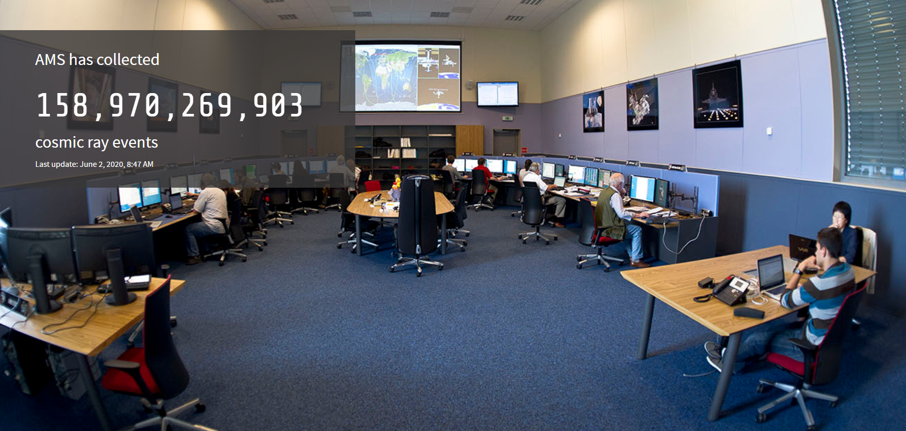
It uses the unique environment of space to study the universe and its origin by searching for antimatter, dark matter while performing precision measurements of cosmic rays' composition and flux.
The AMS Payload Operation Control Center at CERN operates 365 days year h24
The AMS02 detector has collected so far more than 200 billion Cosmic Rays events.
More Info in the AMS-02 webpage:
https://ams02.space

Slide 5
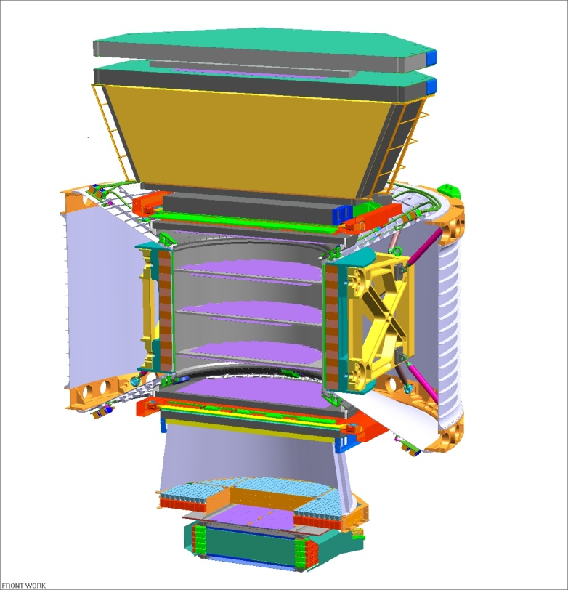
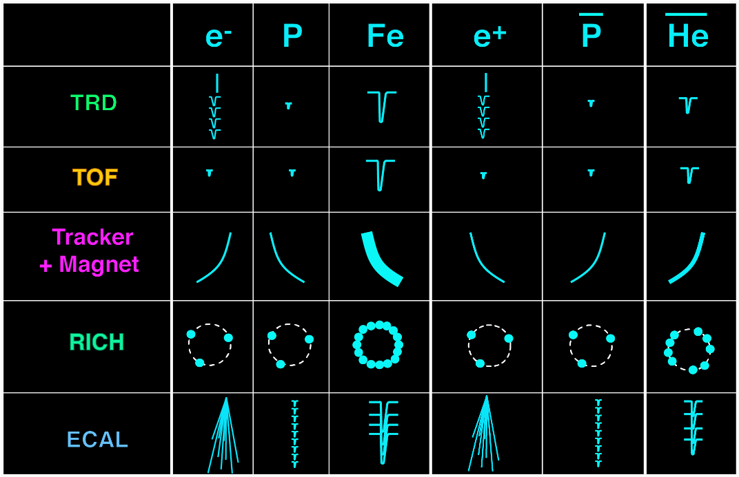
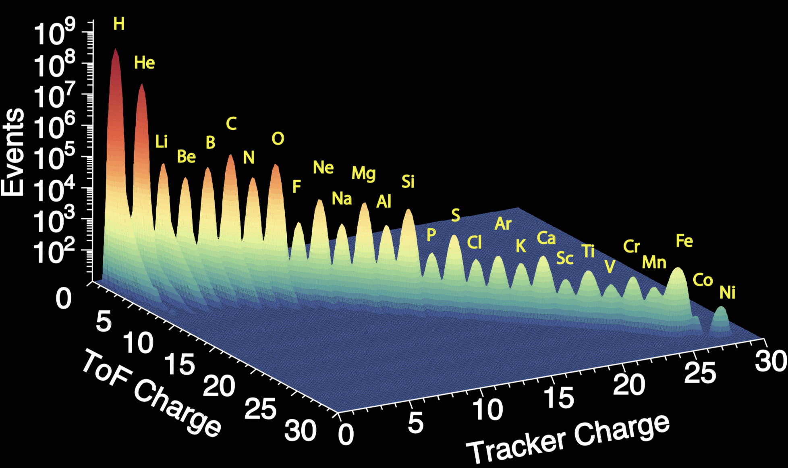
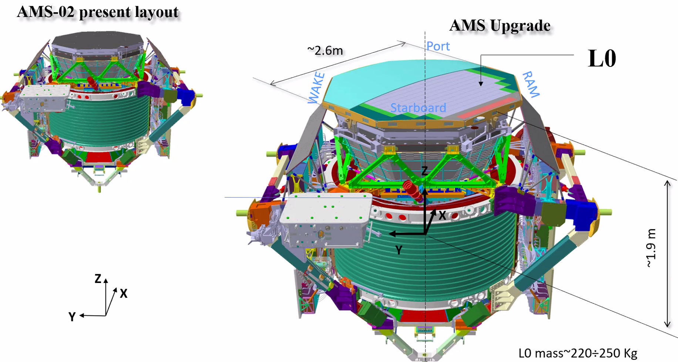
AMS is a space version of a precision detector used at accelerators
particle
anti-particle
Matter
Antimatter
TRD
TOF
Magnet
Tracker
TOF
RICH
ECAL
Cosmic-ray properties
Dark Matter
searches
Primordial antimatter searches
In 2023 an upgrade of the Tracker , a new silicon detection layer, will improve the AMS02 detectors capability
Notes:
AMS is a space version of a precision detector used at accelerators:
It comprises 5 main sub-detectors TRD, TOF, Silicon Tracker + Magnet, RICH and ECAL
It can precisely identify particles and nuclei from their antiparticles
Goal: search for Dark Matter, investigate on the origfin of the universe: antimatter searches

