Slide 1
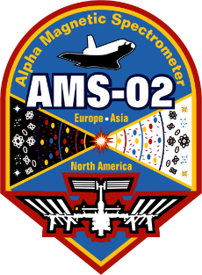
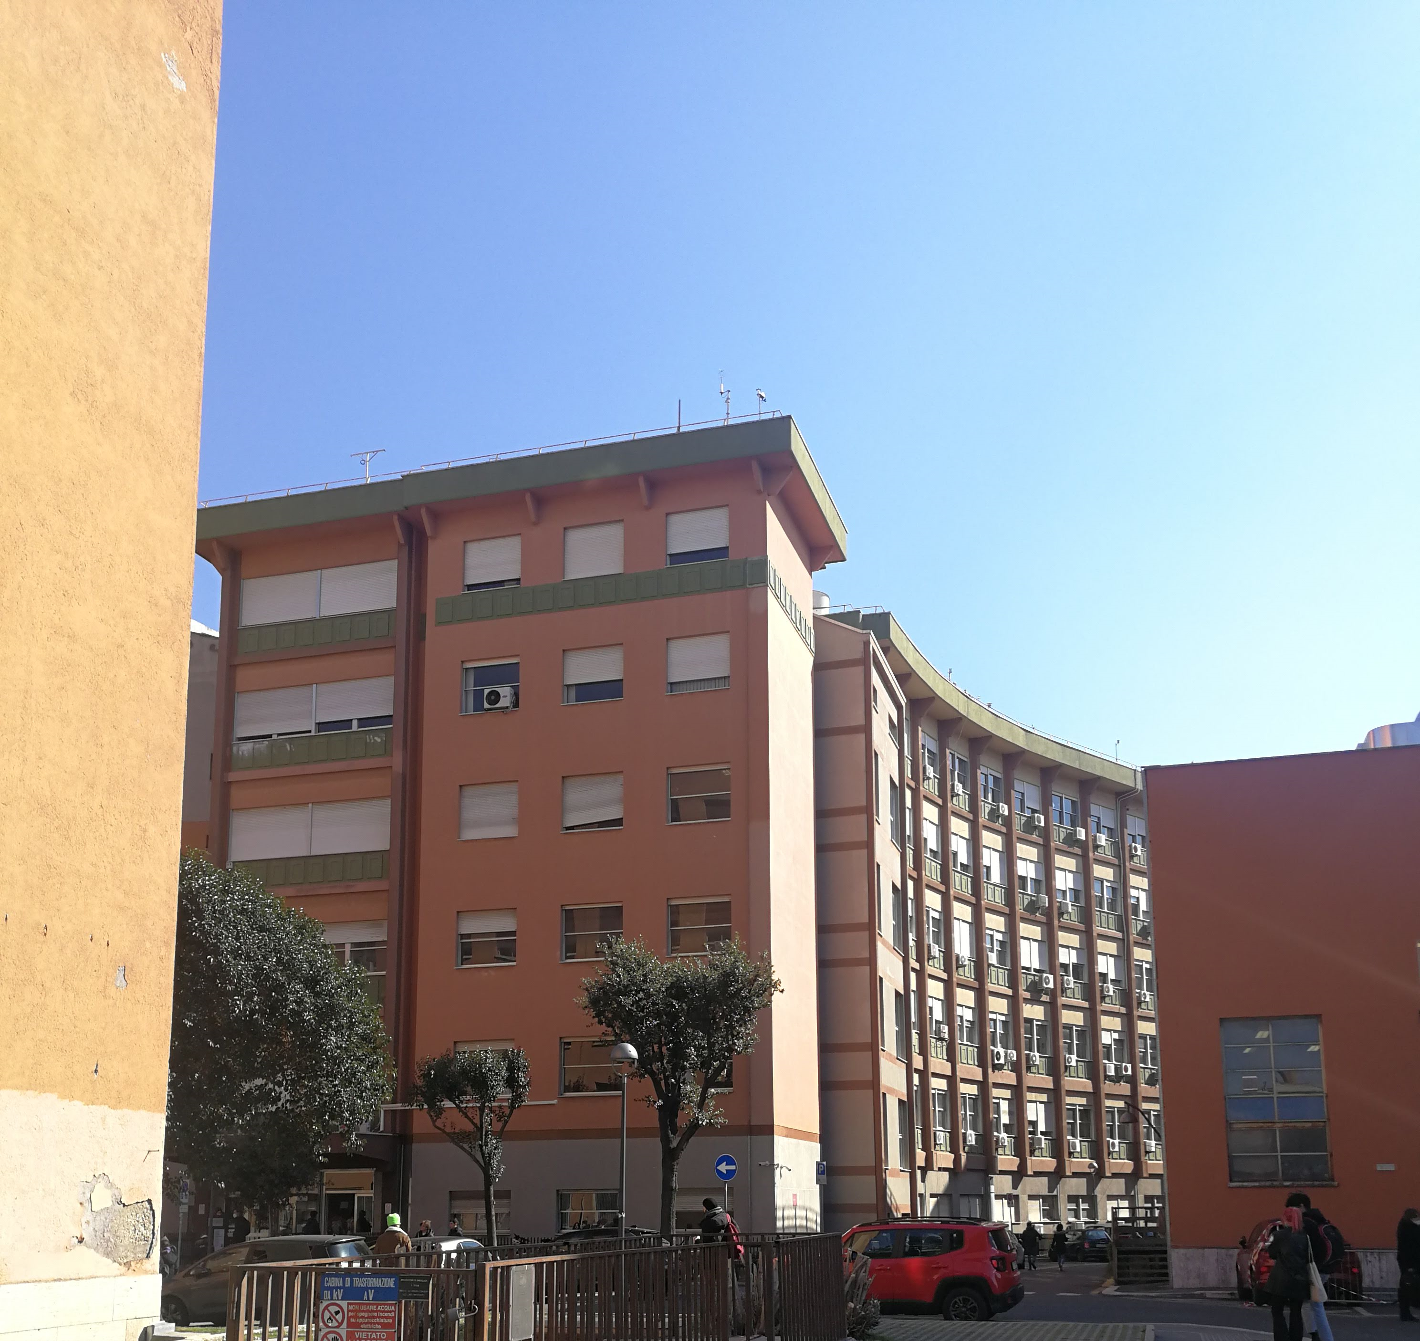
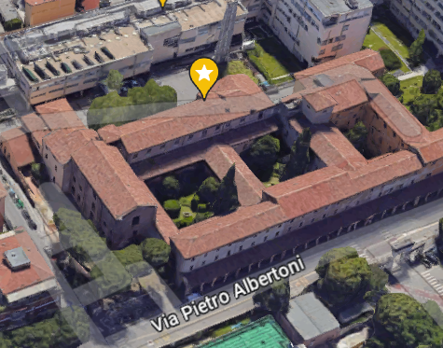
AMS Italia meeting 2023
Alessandro Bartoloni
On behalf of the AMS Roma Sapienza group
Italian Institute for Nuclear Physics (INFN)
Sapienza Università di Roma
Dip. di Fisica Edificio “Enrico Fermi”
IRCCS – Policlinico di S.Orsola
UOC Fisica Sanitaria
Notes:
Space Radiation Characterization for Safe Human Space Exploration and Settlements
Maybe title can be bigger?

Slide 2
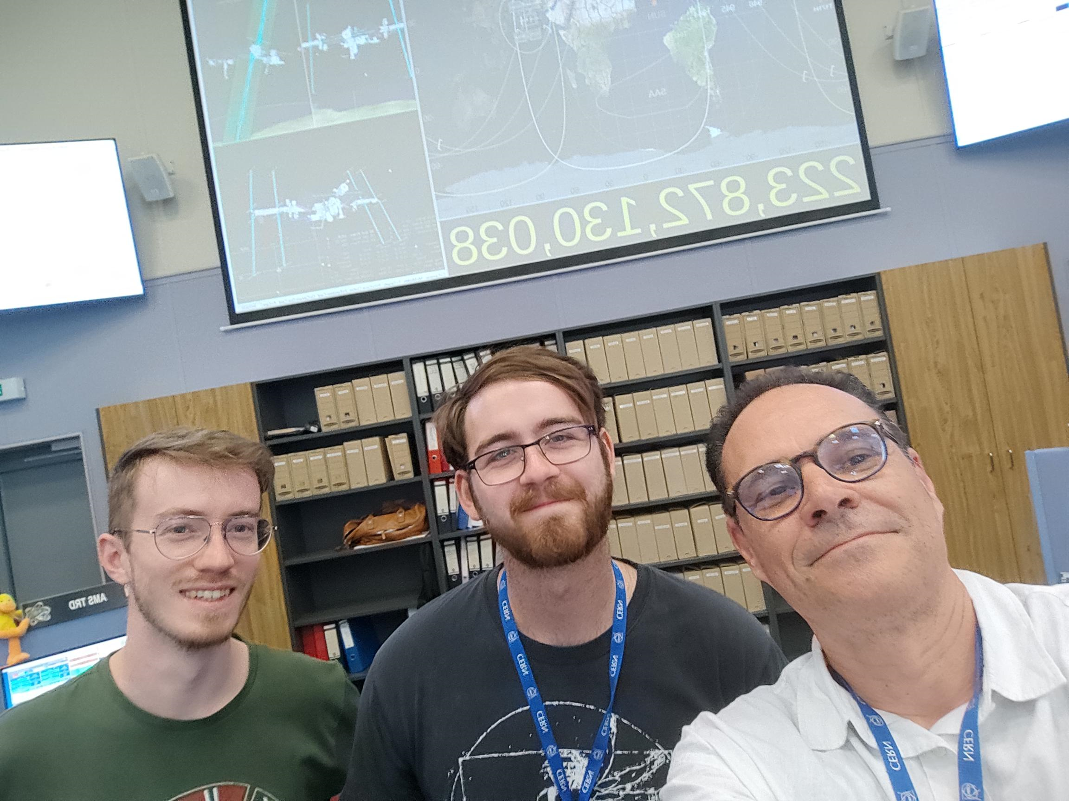
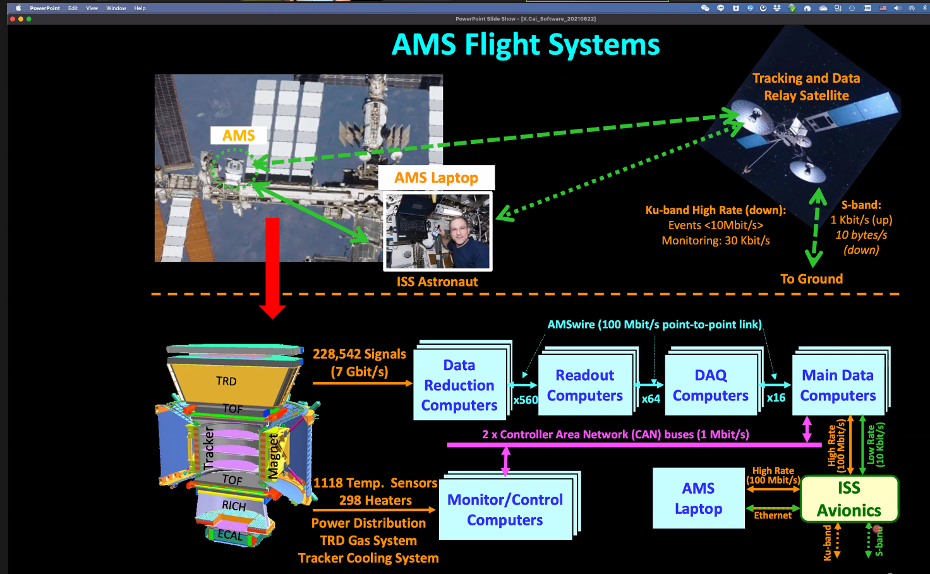
Roma-I group supports AMS operations and hardware upgrade activities since 2011 09/2022-11/2023 3 persons did 6 blocks x 6 days of POCC shifts in the TEE position
August 2023

Slide 3
AMS Roma Sapienza – Raw Data Analysis Team
Who:
A. Bartoloni
AdR (ASI) starting the procedure now
F. Tng (interniship from TUB)
M. Rafiei, S. Parsaei (Kerman University)
When : Started mid-November
What : 1st “exercise” is a SEP proton analysis (2022 SEP)
How : “NAIA style”

Slide 4
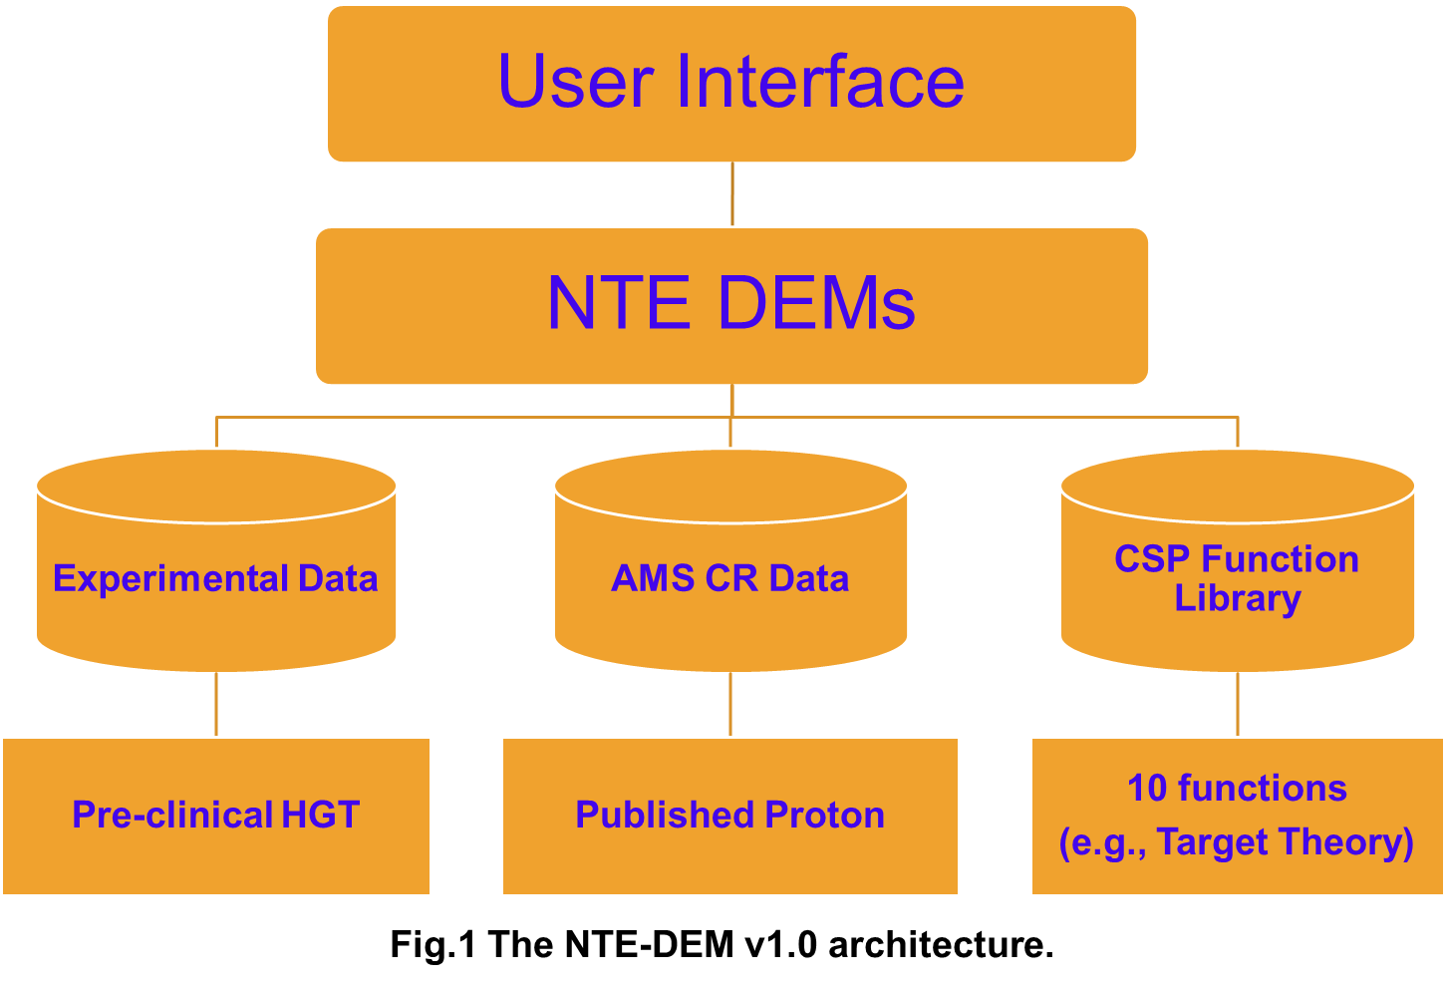
An example on Research activities on DEM in progress at AMS INFN Roma-Sapienza Group
The NTE-DEM aims to combine the existing experimental data (clinical, pre-clinical and in vitro), the cosmic ray fluences, as measured by the AMS detector and the cell survival probability function existing in the literature to produce reliable DEMs.
We use the R-Studio integrated development environment to code it. The first NTE-DEM release (Fig. 1) comprises a main program and several libraries for>10K lines of code.

Slide 5
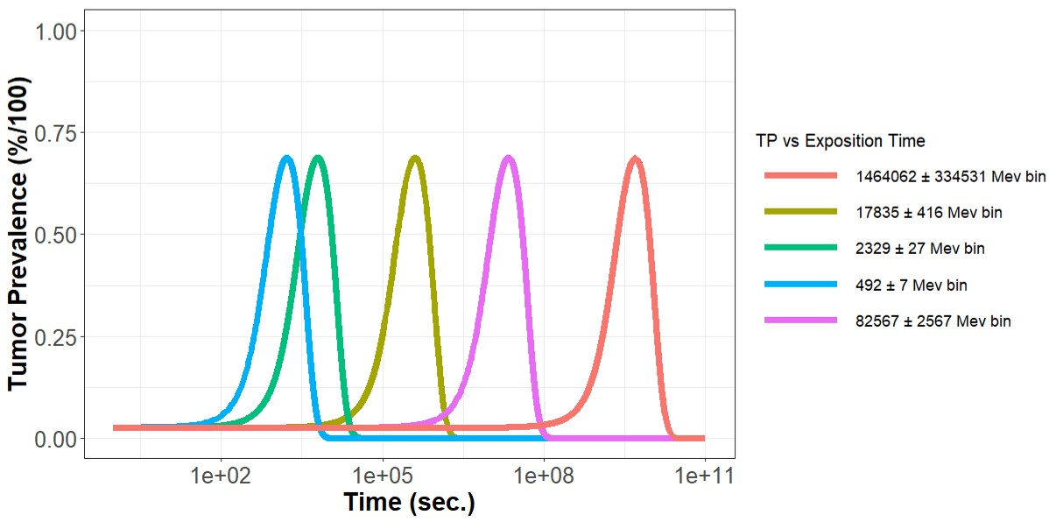
graphics summary of the paper
nTNH
LQ Model
… S-SR
Model
Hazard Function for Gamma ray ($H_{γ}$)
Hazard Function for Charged Particle ($H_{CP}$)
AMS data
Tumor Prevalence for Targeted and Non-targeted Effects (TP_{TE}& TP_{NTE})
Using Alpen et. al. 1993 paper
Cells Survival Probability models
(CSP)
Tumor Prevalence in terms of protons flux and exposition time has been calculated using H functions and plotted for protons for data taken from AMS-02 for different bin energy ranges from 492.4±7 MeV to 1.46±0.335 TeV (from 0.24 KeV/µm2 to 0.04 KeV/µm2 LET values)

Slide 6
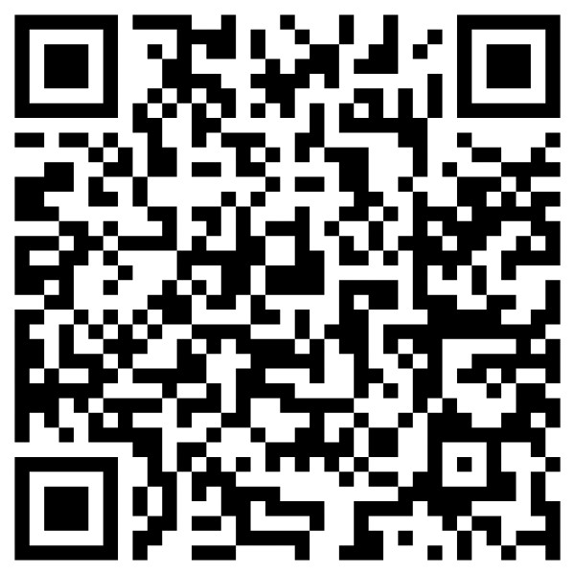
The future evolution of the NTE-DEM
Internal Note (May 2023)
The future evolution of the NTE-DEM software architecture will incorporate advancements to further understand the effects of space radiation exposure.
By utilizing the AMS-02 detector, we will continue to measure and analyze various components of Cosmic Rays (CRs), including electrons and heavy nuclei.
Our ongoing software development aims to enhance the NTE-DEM software architecture by integrating the Radiobiology Mathematical Models' Library, which specifically addresses the biological mechanisms of Non-Targeted Effects (NTE). Additionally, we will leverage AI-based data analysis techniques for more robust and insightful results.
User Interface
Experiment
type
Radiobiology Models’ Library
NTE DEMs
AMS CRs Data
Experimental Data
Effect
in vitro
pre-clinical
Cancer
CVD
CNS
clinical
in vivo
pre-clinical
Heavy Nuclei
Raw
Analisys
Sources
Published
Radiation
Protons
Electrons
AI-based
Analytical

Slide 7
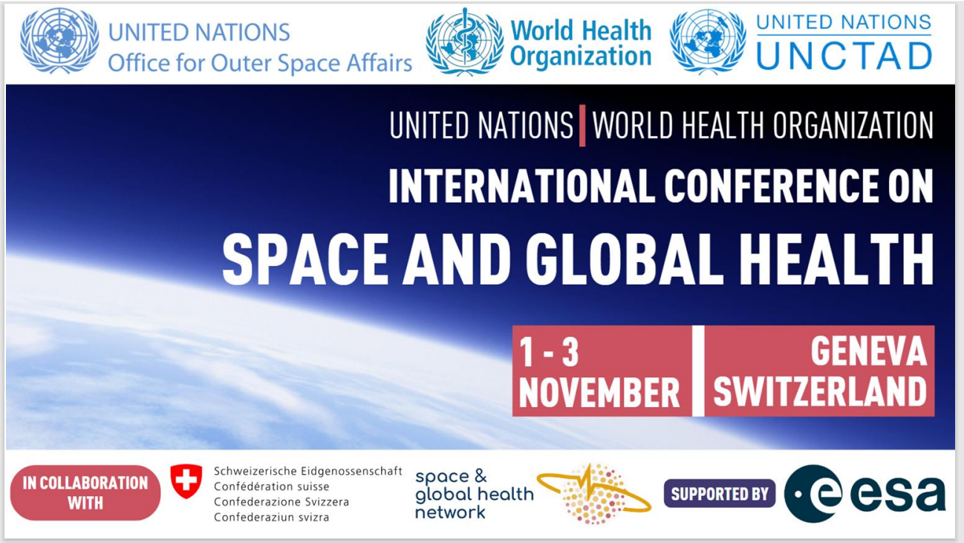

Slide 8
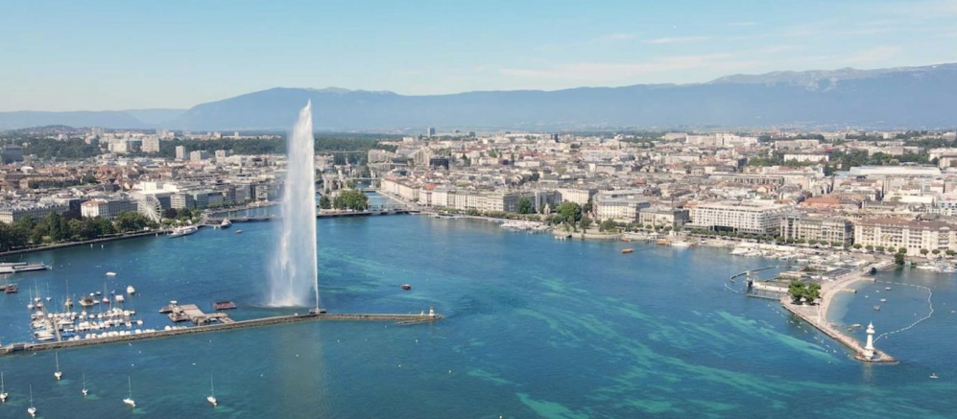
Synergistic Advances in Space Radiation Health Effects:
collaborative insights from AMS Roma Sapienza and Medical Physics Division of IRCCS University Hospital of Bologna
Alessandro Bartoloni
On behalf of the AMS Roma Sapienza group
Italian Institute for Nuclear Physics (INFN)
I gratefully acknowledge the strong support from the AMS collaboration, from the INFN Scientific Committee CNS2 and from the Italian Space Agency (ASI) within the agreement ASI-INFN n. 2019-19-HH.0

Slide 10
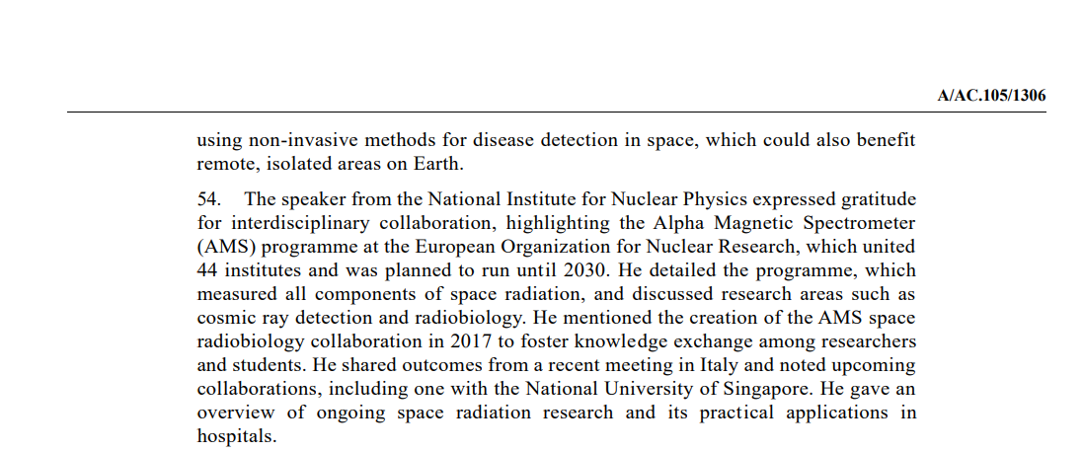

Slide 11
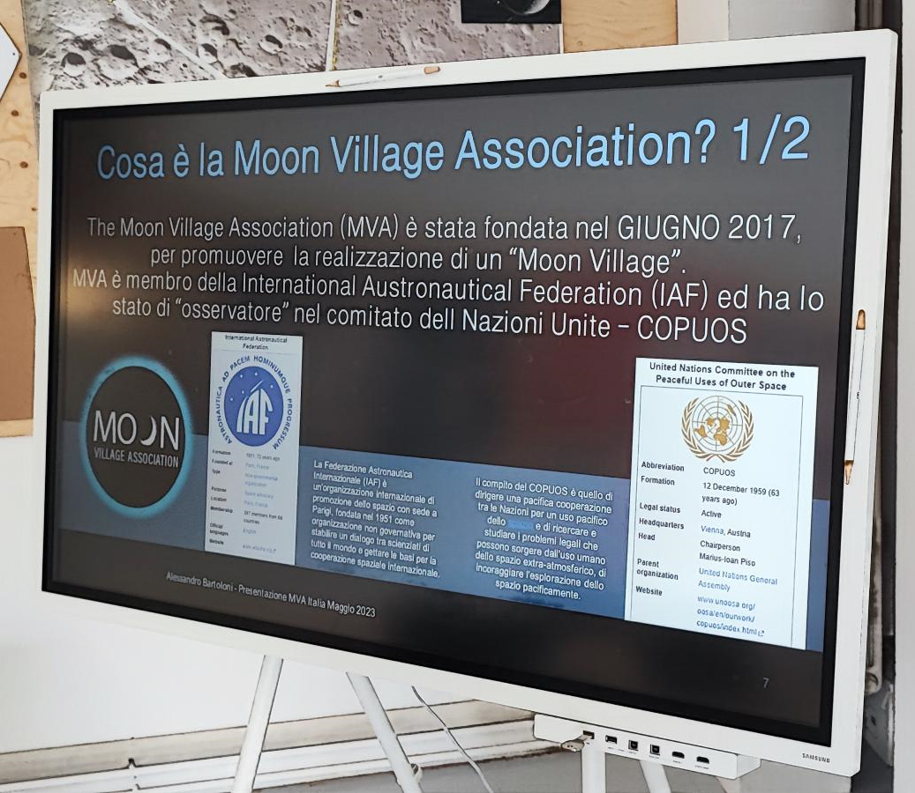
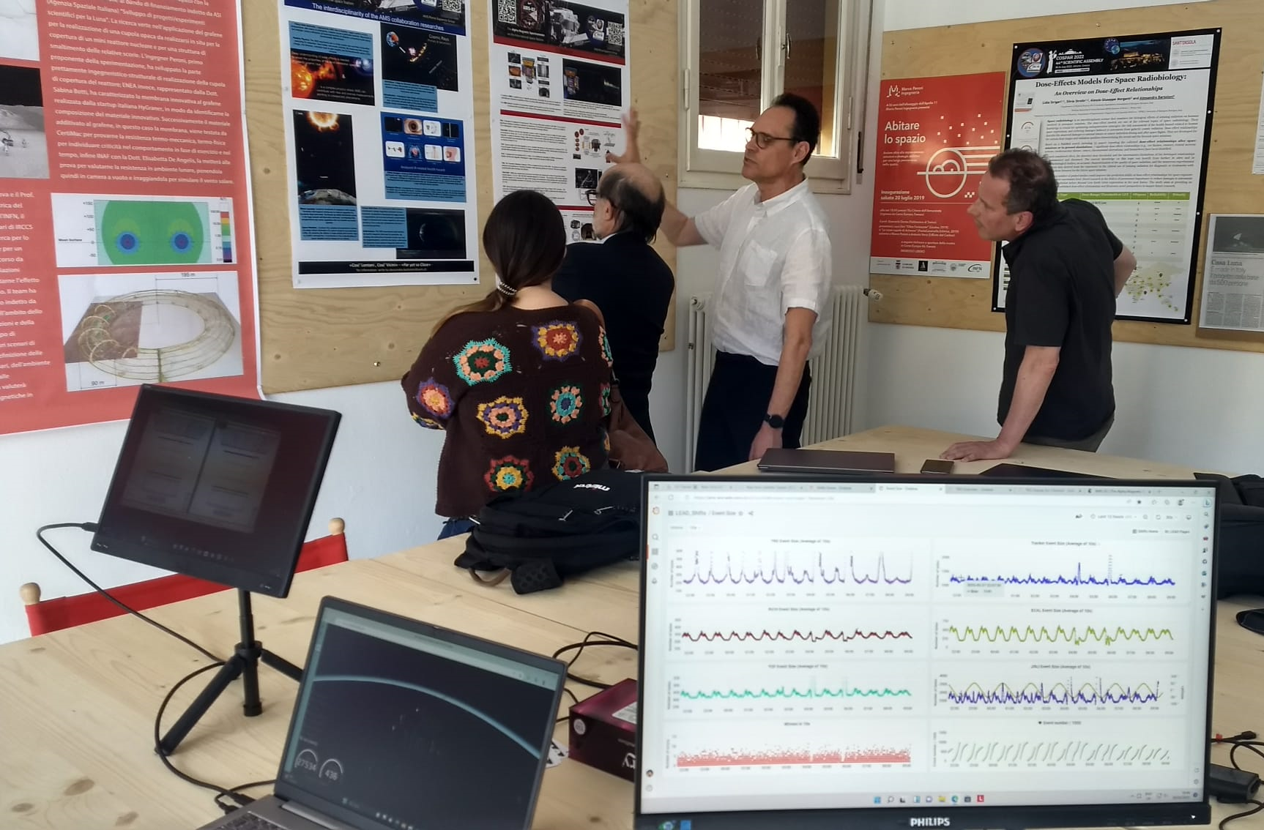
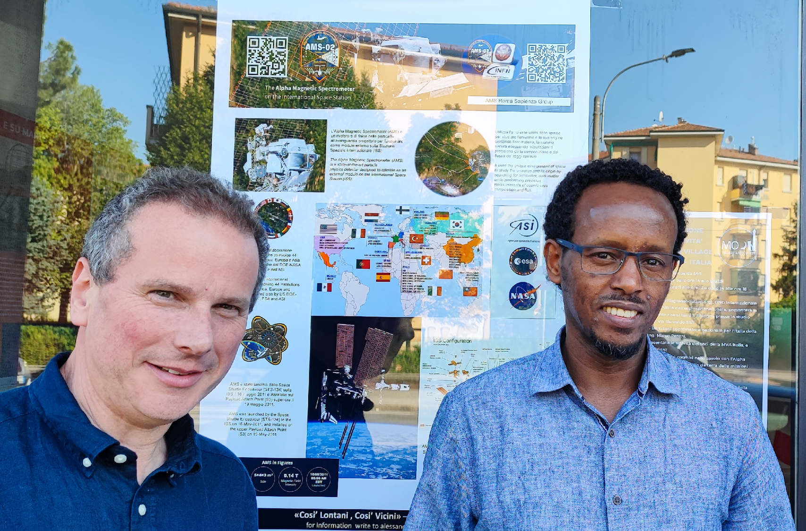

Slide 12
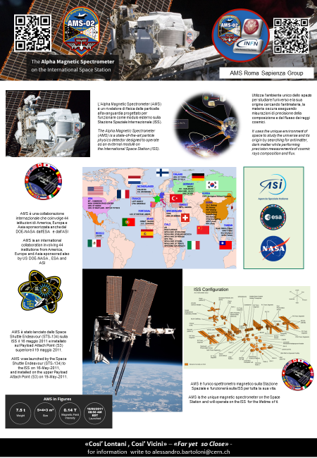
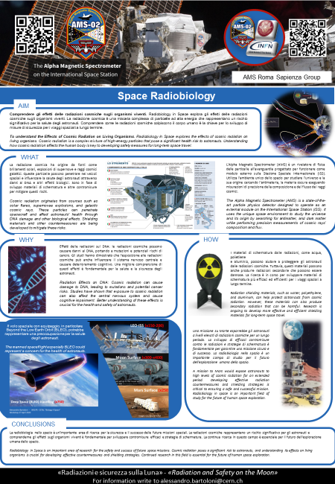
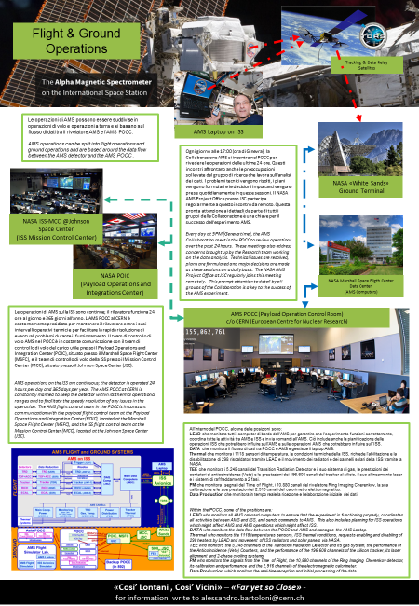
Riproduzione Sala di Controllo del rivelatore AMS
(this activities get an oral talk at the EPS-HEP 2023 Track-14)

Slide 13
The AMS SPRB collaboration was created in 2017 by the synergy of the AMS INFN Roma Sapienza (Italy) group leaded by Alessandro Bartoloni with the medical physics research group leaded by Lidia Strigari currently at IRCCS university Hospital of Bologna (Italy)

Slide 14
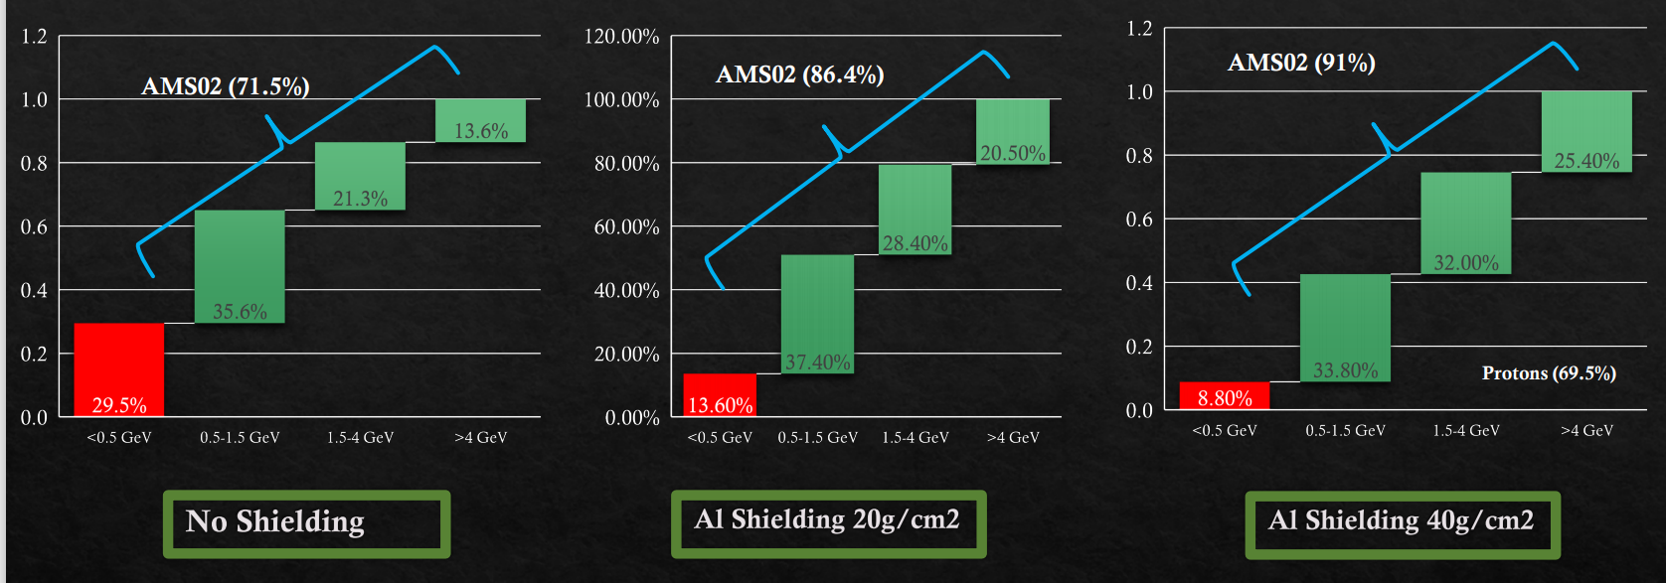
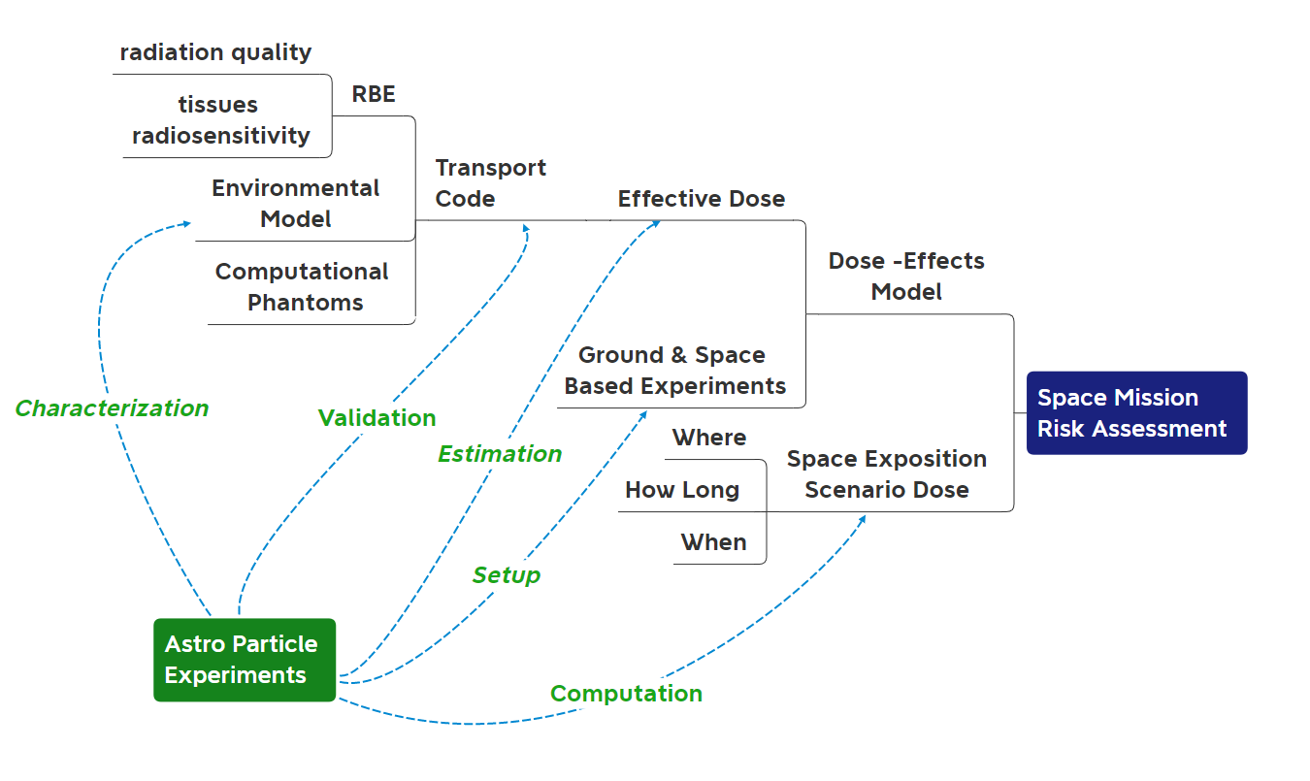
AMS02 GCR sensitivity analysis
Collaborations were mainly focused on creating synergy within different scientific communities
(radiobiology, medical physics, radiotherapy, and nuclear medicine)
Institutions playing a crucial role in the human space exploration
(Research, Universities, and National Space Agencies).
We have many studies on the capabilities and possibilities in that direction, especially regarding the AMS02 and also we identify many opportunities for improvement.
A. Bartoloni ª*, L. Strigari^{b}
SIF2019
A. Bartoloni ª*, L. Strigari^{b}
GLEX-21-8.2.5 (ID:62186)

Slide 15
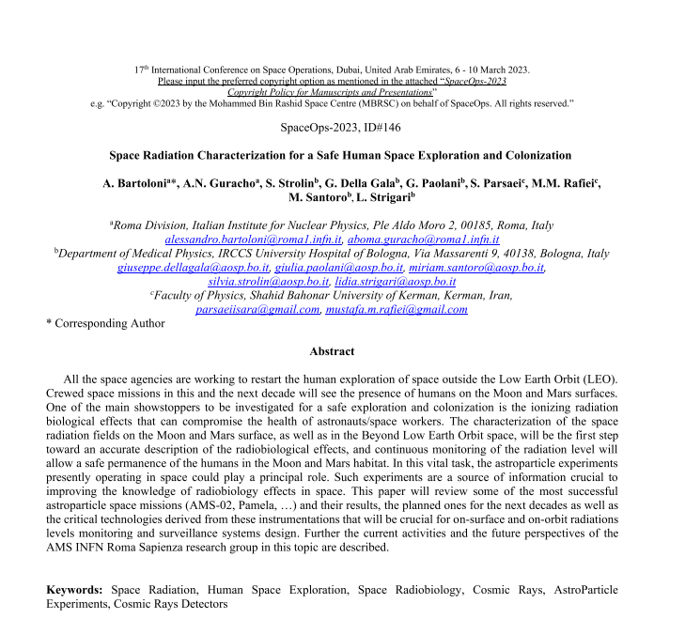
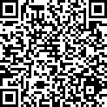
Space Radiation Characterization for Safe Human Space Exploration and Settlements (manuscript accepted 6/4/2023)
Notes:
Space Radiation Characterization for Safe Human Space Exploration and Settlements
Maybe title can be bigger?

Slide 16
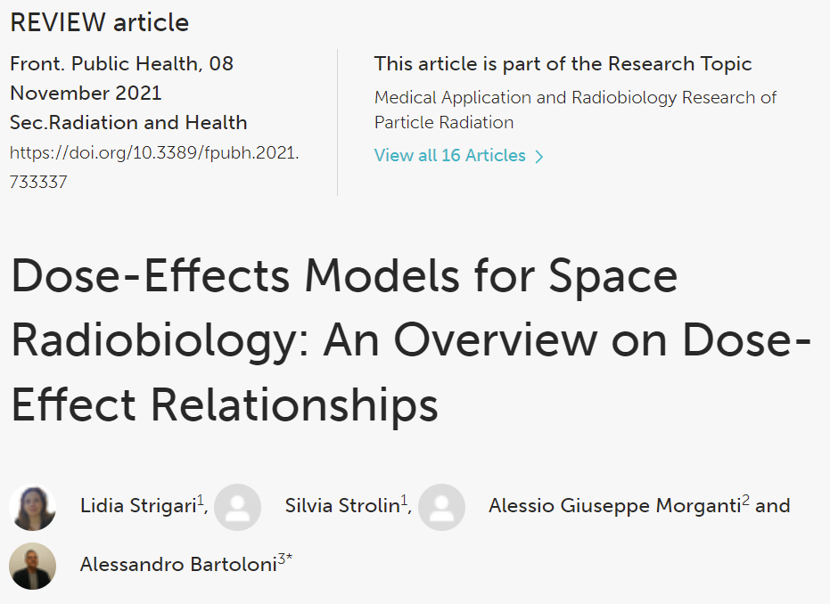
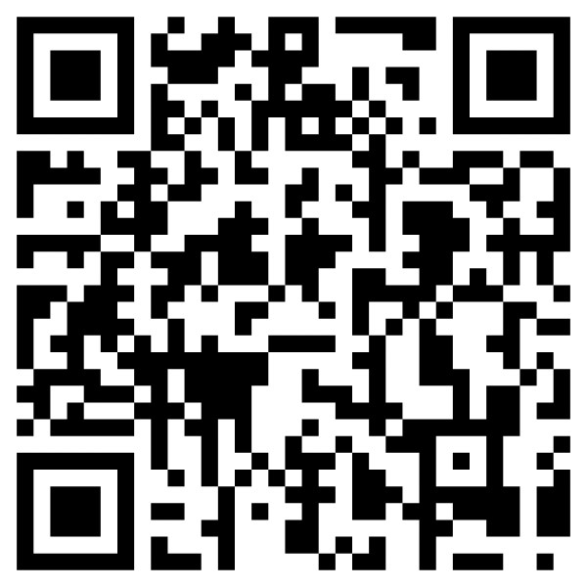
We made and publish in 2021 an extensive review of the existent literature to use as starting point for improvements this research areas
Articles dose-effect models search and identification
Identification of
Types of irradiation
Models
Data
Experimental Type
In Vitro
Clinical
Pre-clinical
Study Type
Ground
Spaceflight
Simulation
https://doi.org/10.3389/fpubh.2021.733337
Notes:
To improve dose-effect models, the following steps are mandatory integrating the vitro and in vivo data (from preclinical data and human exposure). A platform to collect these data are required to explore and identify dose-effect models.
,

Slide 17
Model | Study Type | Dose Range/Threshold or LET | #Papers
Eye Flashes | Spaceflight | LET>5-10 KeV/µm | 4
Cataract | Spaceflight | 8 mSv | 5
CNS | Ground/Simulations | 100-200 mGy | 11
CVD | Spaceflight | 1000 mGy | 4
 | Ground/Simulations | 0.1-4,500 mSv | 8
Cancer | Spaceflight | < 100 mGy | 2
 | Ground/Simulations | < 100 mGy | 9
Biomarkers or Chromosomal Aberrations | Spaceflight | <5-150 mGy | 11
 | Ground /Simulations | < 10,000 mGy | 4
Other Risks | Ground/Simulations | 2,000 mGy | 2
*= Very Low, **=Low,***=Medium,**** = High, ***** = Very High.
Article Statistics (June 26, 2022)

Slide 18
Further investigation are required to produce dose-effects models that will allows to predict the risk due to radiation during the space exploration
Computer Simulation of interactions of IR with biological matter »
Synergy with the Clinical Field
Mathematical Modelling
Quantitative Meta Analysis
Radioprotectors inclusion in DER
Individual Radio Susceptibility
Dose-Effects Model Integration Platform
Synergy with Astroparticle Experiments
Notes:
Computer Simulation of interactions of IR with biological matter
Simplified 3D neuron models with properties equivalent to realistic neuron morphology have been developed using GEANT4 to describe the effect observed in rats after a dose from 0.1 to 2 Gy delivered to the hippocampus Of note, the changes to synapses are one aspect to be considered.
Synergy with the Clinical Field :
The possible risks to astronauts chronically exposed to space radiation could prevent astronauts from performing complex executive functions which are to be deeply investigated after radiotherapy for brain cancers.
Mathematical Modelling :
Cacao E and Cucinotta FA in 2016 reported a predictive mathematical model of radiation-induced changes to neurogenesis for various radiation types after acute or fractionated irradiation, extending a mouse model of impaired neurogenesis in the hippocampal dentate gyrus after exposure to low-LET radiation to heavy ion irradiation.
Quantitative Meta Analysis
recently, the first quantitative meta-analysis of the dose-response for proton and heavy-ion rodent studies has been published based on the widely used novel object recognition test, which estimates detriments in recognition or object memory (27). The log-normal model predicts a heavy-ion dose threshold of ~0.01 Gy for novel object recognition-related cognitive detriments.
Radioprotectors effects in models :
One of the most promising ways to prevent and mitigate the acute effects of CNS and the neurocognitive impairment during long-term spaceflight is based on the use of substances (e.g., Dammarane Sapogenins)
Individual radio susceptibility should be considered in dose-effect models predicting the radiation-induced CNS changes.
Synergy with the Astroparticle experiments ….

Slide 19
Target Effects vs Non Target Effects
Following this analysis, we started to investigate one of the promising and not yet understood effects of ionization radiation, usually referred to as the non-targeted effect (NTE) of great relevance for space radiation.
In-vitro and in-vivo pre-clinical studies as well as many mechanistic studies support the NTEs, with evidence of a a supra-linear effects at low doses of NTE compared to the linear one of TE
NTEs include bystander effects where cells traversed by heavy ions transmit oncogenic signals to nearby cells and genomic instability in the cell's progeny.
The NTE are expected also at the fluences and space radiation species that occur in space

Slide 20
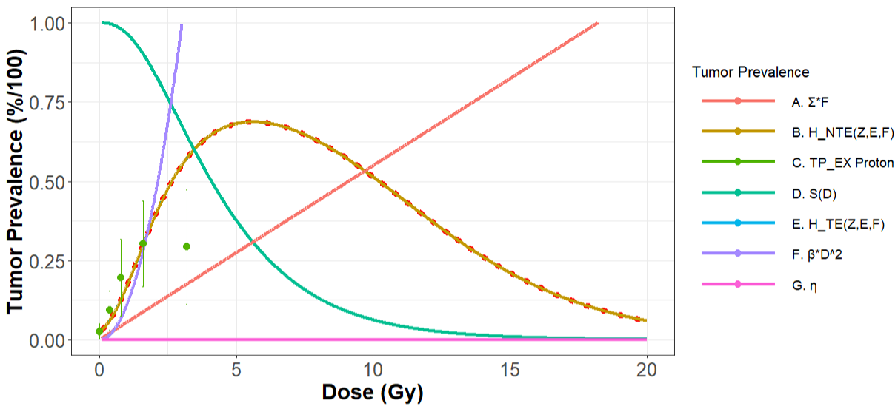
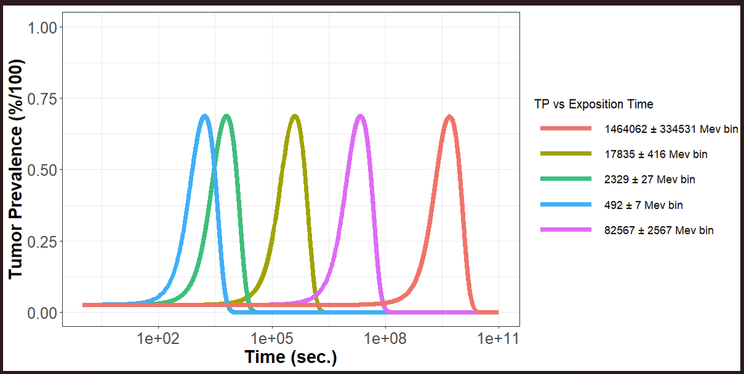
Journal of Mechanics in Medicine and Biology
“SPACE RADIATION INDUCED BYSTANDER EFFECT IN ESTIMATING THE
CARCINOGENIC RISK DUE TO GALACTIC COSMIC RAYS” A. Guracho et al (published in May 2023)
Tumor Prevalence Dose Effects Model
Proton Model (HGT)
Hazard Function for Target effects
«AMS02 Protons»
Hazard Function for Target + Non Target Effects

Slide 21
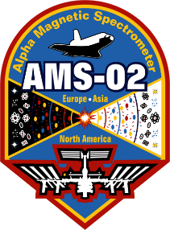
AMS Roma-I group activities in 2023/24
Support of AMS operations at POCC
Research in Space Radiobiology in collaboration with IRCCS University Hospital of Bologna (IRCCS-AOUBo)
Research in Space Radiation (GCRs,…) also in collaboration with Shahid Bahonar University of Kerman (SBUK)
Editorial and Outreach activities
AMS Roma-I People 2023/24
INFN – Roma A. Bartoloni – (1/Si), B. Borgia (0/Si), A.N. Guracho (1/Si), 2nd year AdR since November 2022 , V. Valente (0/Si)
IRCCS AOUBo – F. Bisello (0,3/No), G. Della Gala (0.3/No), K.E. Gzylasy (0,3/No), C. Macis (0.3/No) , M. Santoro, (0,3/No), L. Strigari (0.8/Si), S. Strolin (0.3/No)
SBUK – S. Parsaei (0.3/No) , M. Rafiei – (0.3/No)
2024 FTE & Funding Requests (Keuro) (preliminary) | FTE e Richieste (Keuro) per il 2022
Persone |  |  | FTE
13 (4 RM1, 7 AOUBo 2 SBUK) |  |  | 5.2 (2.8 richieste )
Missioni | Consumi | Servizi | Inventariabile | Totale
12 | 1.5 | 2.5 | 3 | 19

Slide 22
AMS02
(Space Cosmic Ray Detectors)
Research
Keywords
Human Space Exploration
Space Radiation & Radiobiology

Slide 23
The AMS SPRB collaboration was created in 2017 by the synergy of the AMS INFN Roma Sapienza (Italy) group leaded by Alessandro Bartoloni with the medical physics research group leaded by Lidia Strigari currently at IRCCS university Hospital of Bologna (Italy)
IRCCS – Policlinico di S.Orsola
UOC Fisica Sanitaria
Sapienza Università di Roma
Dip. di Fisica Edificio “Enrico Fermi”

Slide 24
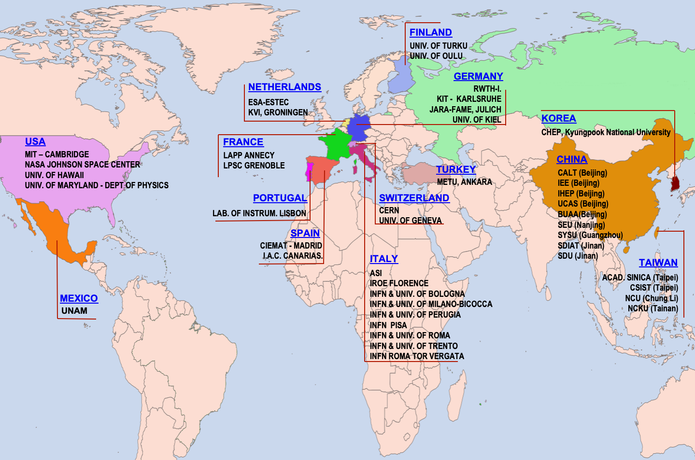
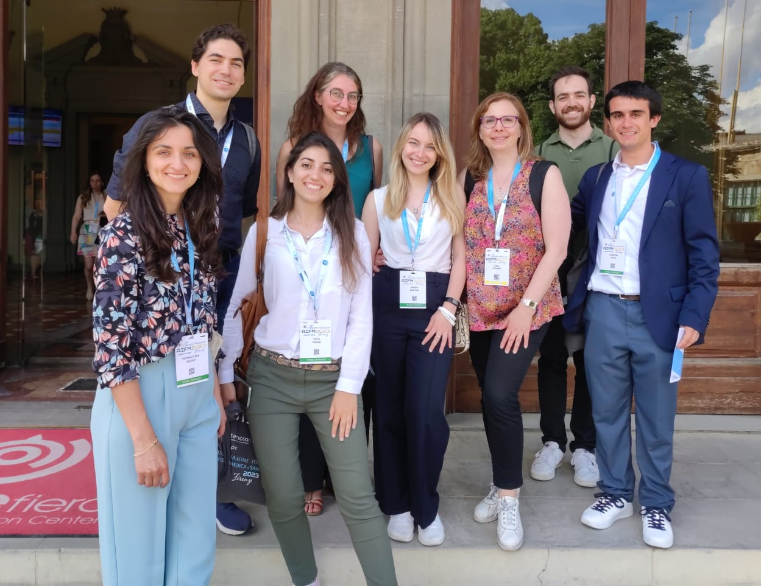
AMS INFN-Roma Sapienza
Aboma Negasa
Guracho
Silvia
Strolin
Klarisa Elena
Gzilasy
Miriam
Santoro
Lidia
Strigari
Francesca
Bisello
Klarisa
Gzilasy
Lorenzo
Spagnoli
Christian
Macis
Giuseppe
Della Gala

Slide 25
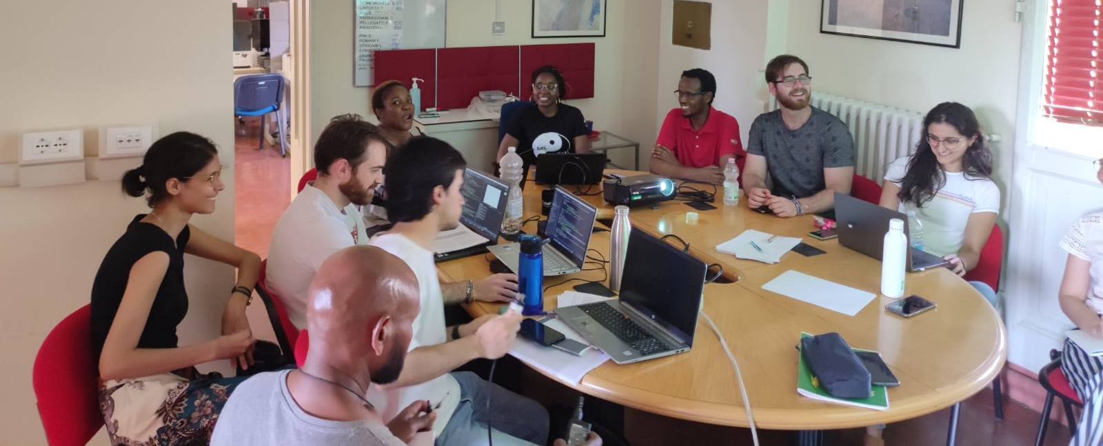
2nd AMS/SPRB InterchangE Meeting (Bologna 18-20 July 2023)

Slide 26
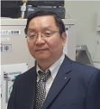
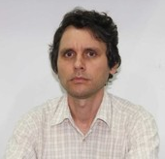
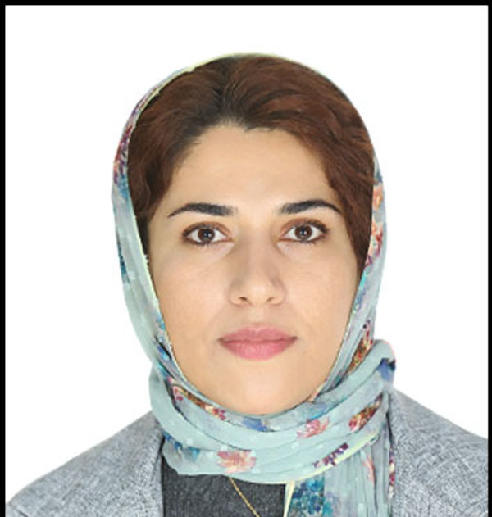
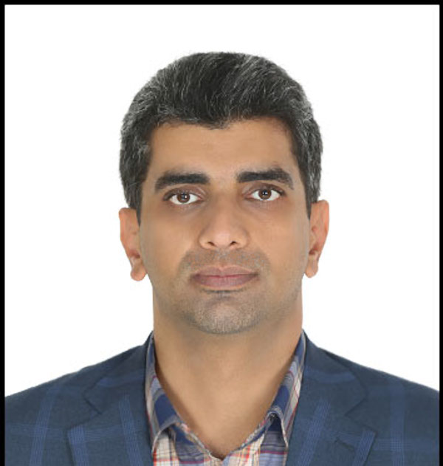
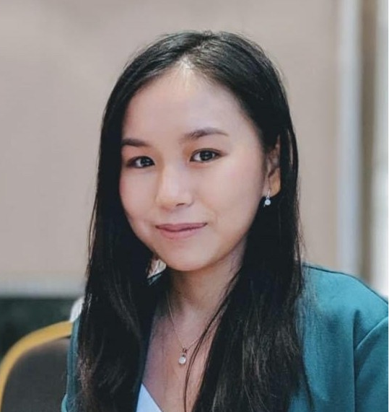
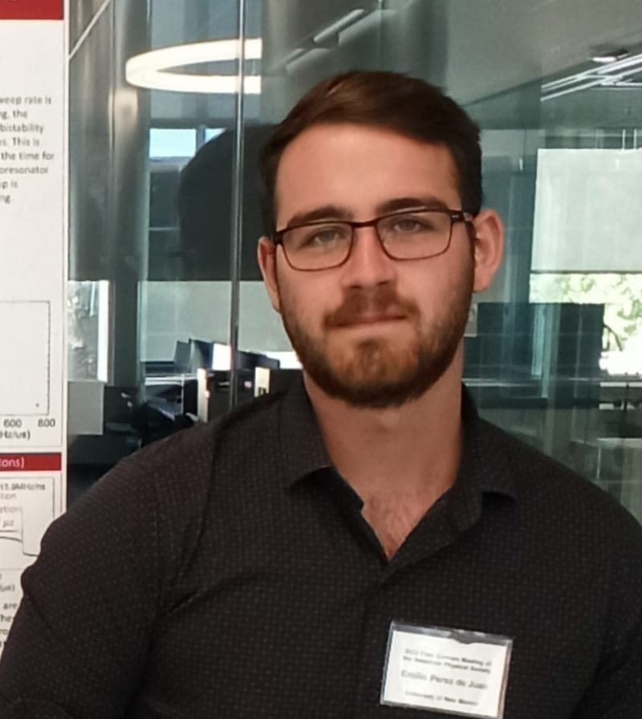
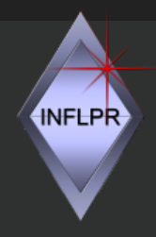
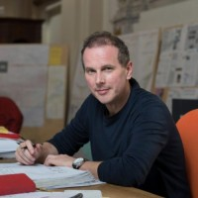
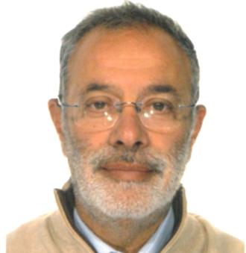
AMS INFN Roma Sapienza Group Collaborations started in 2023
Feng
Ru Tang
National University of Singapore
Aurelian
Marcu
National Institute for Laser, Plasma and Radiation Physics - Romania
Sara
Parsaei
Mustafa
Rafiei
Faith
Tng
Emilio
Perez De Juan
Shahid Bahonar University of Kerman
Space Generation
Advisory Council
Marco
Peroni
Peroni Ingegneria
Maurizio
Repetto
Politecnico di Torino
Antonio
Della Corte
ICAS srl

Slide 27
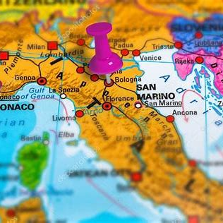
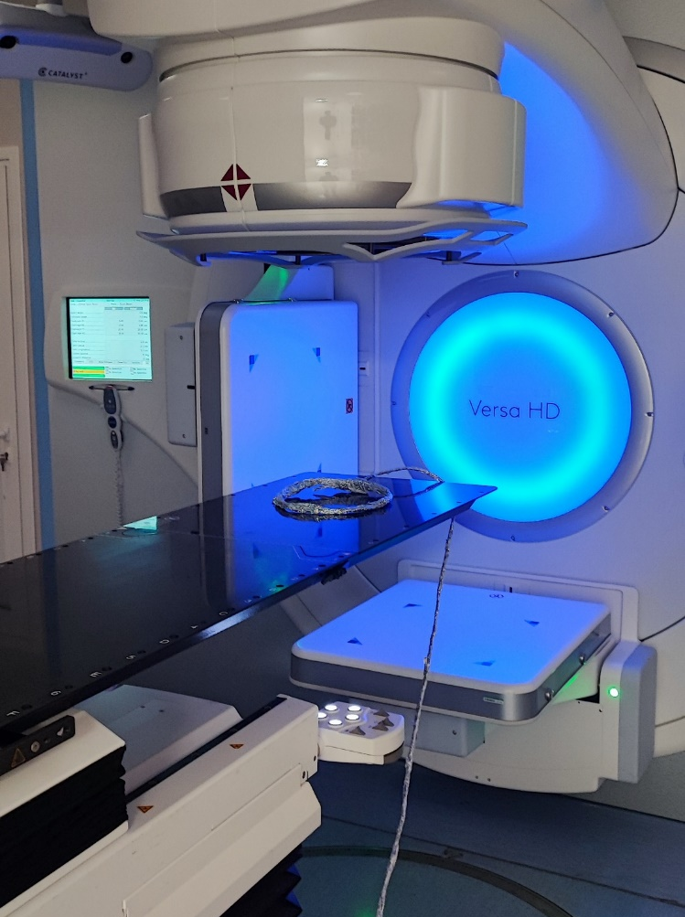
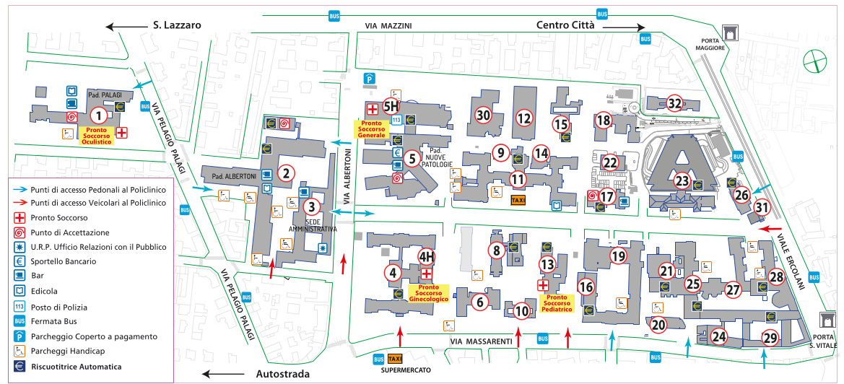
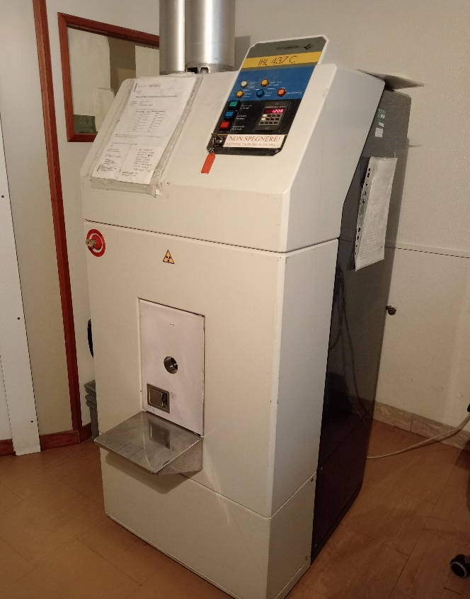
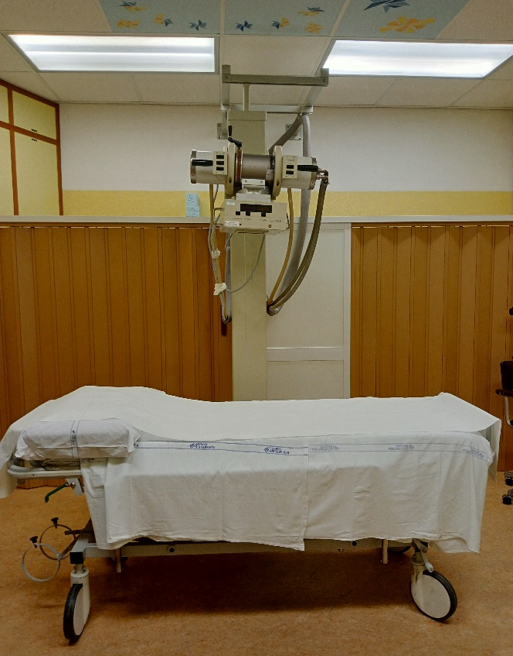
IRCCS Azienda Ospedaliero-Universitaria di Bologna Department of Medical Physics Bologna, Italy
4 linacs (Electrons & Gamma Ray)
1 Brachytherapy High Dose Rate system (¹⁹²Ir)
1 Roentgen-therapy
1 ¹³⁷Cs Irradiator
1 CT for RT planning
3 Versa HD
(6MV, 6FFF, 10MV, 10FFF, 15MV)
Siemens
(6MV ,18MV)
34 buildings
Microselectron HDR ¹⁹²Ir A=500 GBq
¹³⁷Cs Irradiator
A=36.67 TBq
RX THERAPAX 300
(300kV )

Slide 28
We made and publish in 2021 an extensive review of the existent literature to use as starting point for improvements this research areas
Articles dose-effect models search and identification
Identification of
Types of irradiation
Models
Data
Experimental Type
In Vitro
Clinical
Pre-clinical
Study Type
Ground
Spaceflight
Simulation
https://doi.org/10.3389/fpubh.2021.733337
Notes:
To improve dose-effect models, the following steps are mandatory integrating the vitro and in vivo data (from preclinical data and human exposure). A platform to collect these data are required to explore and identify dose-effect models.
,

Slide 29
Model | Study Type | Dose Range/Threshold or LET | #Papers
Eye Flashes | Spaceflight | LET>5-10 KeV/µm | 4
Cataract | Spaceflight | 8 mSv | 5
CNS | Ground/Simulations | 100-200 mGy | 11
CVD | Spaceflight | 1000 mGy | 4
 | Ground/Simulations | 0.1-4,500 mSv | 8
Cancer | Spaceflight | < 100 mGy | 2
 | Ground/Simulations | < 100 mGy | 9
Biomarkers or Chromosomal Aberrations | Spaceflight | <5-150 mGy | 11
 | Ground /Simulations | < 10,000 mGy | 4
Other Risks | Ground/Simulations | 2,000 mGy | 2
*= Very Low, **=Low,***=Medium,**** = High, ***** = Very High.
Article Statistics (June 26, 2022)

Slide 30
Further investigation are required to produce dose-effects models that will allows to predict the risk due to radiation during the space exploration
Computer Simulation of interactions of IR with biological matter »
Synergy with the Clinical Field
Mathematical Modelling
Quantitative Meta Analysis
Radioprotectors inclusion in DER
Individual Radio Susceptibility
Dose-Effects Model Integration Platform
Synergy with Astroparticle Experiments
Notes:
Computer Simulation of interactions of IR with biological matter
Simplified 3D neuron models with properties equivalent to realistic neuron morphology have been developed using GEANT4 to describe the effect observed in rats after a dose from 0.1 to 2 Gy delivered to the hippocampus Of note, the changes to synapses are one aspect to be considered.
Synergy with the Clinical Field :
The possible risks to astronauts chronically exposed to space radiation could prevent astronauts from performing complex executive functions which are to be deeply investigated after radiotherapy for brain cancers.
Mathematical Modelling :
Cacao E and Cucinotta FA in 2016 reported a predictive mathematical model of radiation-induced changes to neurogenesis for various radiation types after acute or fractionated irradiation, extending a mouse model of impaired neurogenesis in the hippocampal dentate gyrus after exposure to low-LET radiation to heavy ion irradiation.
Quantitative Meta Analysis
recently, the first quantitative meta-analysis of the dose-response for proton and heavy-ion rodent studies has been published based on the widely used novel object recognition test, which estimates detriments in recognition or object memory (27). The log-normal model predicts a heavy-ion dose threshold of ~0.01 Gy for novel object recognition-related cognitive detriments.
Radioprotectors effects in models :
One of the most promising ways to prevent and mitigate the acute effects of CNS and the neurocognitive impairment during long-term spaceflight is based on the use of substances (e.g., Dammarane Sapogenins)
Individual radio susceptibility should be considered in dose-effect models predicting the radiation-induced CNS changes.
Synergy with the Astroparticle experiments ….

Slide 31
Target Effects vs Non Target Effects
Following this analysis, we started to investigate one of the promising and not yet understood effects of ionization radiation, usually referred to as the non-targeted effect (NTE) of great relevance for space radiation.
In-vitro and in-vivo pre-clinical studies as well as many mechanistic studies support the NTEs, with evidence of a a supra-linear effects at low doses of NTE compared to the linear one of TE
NTEs include bystander effects where cells traversed by heavy ions transmit oncogenic signals to nearby cells and genomic instability in the cell's progeny.
The NTE are expected also at the fluences and space radiation species that occur in space

Slide 32
An example on Research activities on DEM in progress at AMS INFN Roma-Sapienza Group
The NTE-DEM aims to combine the existing experimental data (clinical, pre-clinical and in vitro), the cosmic ray fluences, as measured by the AMS detector and the cell survival probability function existing in the literature to produce reliable DEMs.
We use the R-Studio integrated development environment to code it. The first NTE-DEM release (Fig. 1) comprises a main program and several libraries for>10K lines of code.

Slide 33
«AMS02 Protons»
Tumor Prevalence Dose Effects Model
for Proton using HGT data
Target Effects vs Non Target Effects
the dose effects model consistency was proved also using the AMS measure of the GCRs proton components
Journal of Mechanics in Medicine and Biology
“SPACE RADIATION INDUCED BYSTANDER EFFECT IN ESTIMATING THE
CARCINOGENIC RISK DUE TO GALACTIC COSMIC RAYS” A. Guracho et al (published in May 2023)

Slide 34
Towards the Heavy Nuclei : annual dose as an example
Using the AMS data that provide the monthly values of the Electrons, Protons and Helium and the corresponding time variations in the energy range from 1 Gv : 60 GV , using the tool we calculated the annual dose expected from this components in the period. May 2011 –My 2012.

Slide 36
The future evolution of the NTE-DEM software
Internal Note (May 2023)
The future evolution of the NTE-DEM software architecture will incorporate advancements to further understand the effects of space radiation exposure.
By utilizing the AMS-02 detector, we will continue to measure and analyze various components of Cosmic Rays (CRs), including electrons and heavy nuclei.
Our ongoing software development aims to enhance the NTE-DEM software architecture by integrating the Radiobiology Mathematical Models' Library, which specifically addresses the biological mechanisms of Non-Targeted Effects (NTE). Additionally, we will leverage AI-based data analysis techniques for more robust and insightful results.
User Interface
Experiment
type
Radiobiology Models’ Library
NTE DEMs
AMS CRs Data
Experimental Data
Effect
in vitro
pre-clinical
Cancer
CVD
CNS
clinical
in vivo
pre-clinical
Heavy Nuclei
Raw
Analisys
Sources
Published
Radiation
Protons
Electrons
AI-based
Analytical

Slide 37
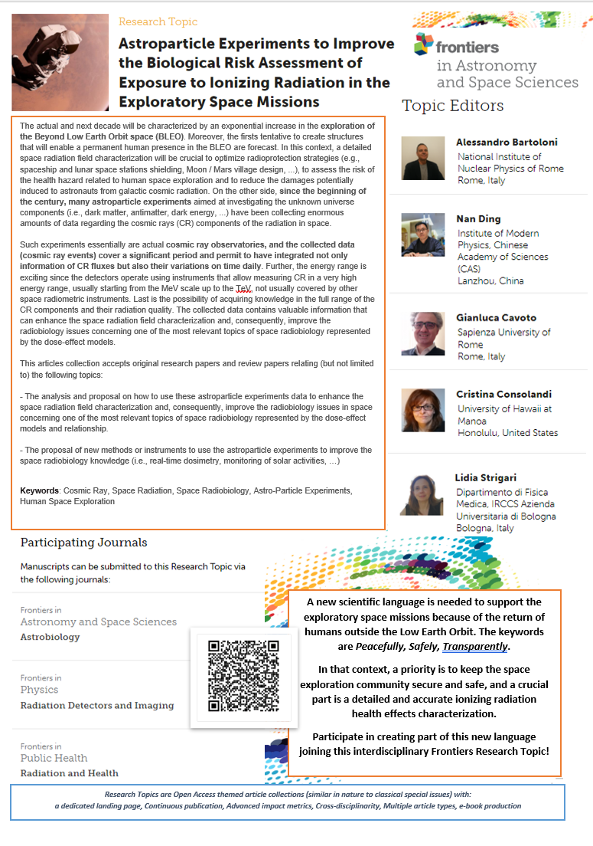
The Research Topic Initiative
Research Topics are Open Access themed article collections with:
dedicated landing page,
continuous publication,
advanced impact metrics,
cross-disciplinarity,
multiple article types,
e-book production

Slide 38
The Research Topic Initiative
As we made progress in our research activities, it became evident that advancing in this field required the development of a new scientific language capable of connecting and fostering synergy among different scientific communities. Researchers in this domain need to incorporate fundamentals of biology, physics, astrophysics, planetary science, and engineering to understand the relationship between ionizing radiation and biology and to address the associated challenges.
The ongoing efforts in space exploration and colonization have garnered global hopes for a new era marked by transparency and peaceful development. In this context, these expectations align with our primary scientific interests, and science could play a pivotal role in realizing such a vision.
Among the many possibilities, we have decided, supported, and encouraged by the Frontiers Editorial team, to launch this research topic named
"Astroparticle Experiments to Improve the Biological Risk Assessment of Exposure to Ionizing Radiation in Exploratory Space Missions."
-

Slide 39
Editors
Cristina
Consolandi
Lidia
Strigari
Nan
Ding
Gianluca
Cavoto
Alessandro
Bartoloni
We created a research topic editorial board that was representative of different scientific cultures and geographic areas and invited many researchers and scientists from many different research areas due to the strong interdisciplinarity of the topic.

Slide 40
Interdisciplinary Topic
Contributors from different research areas

Slide 41
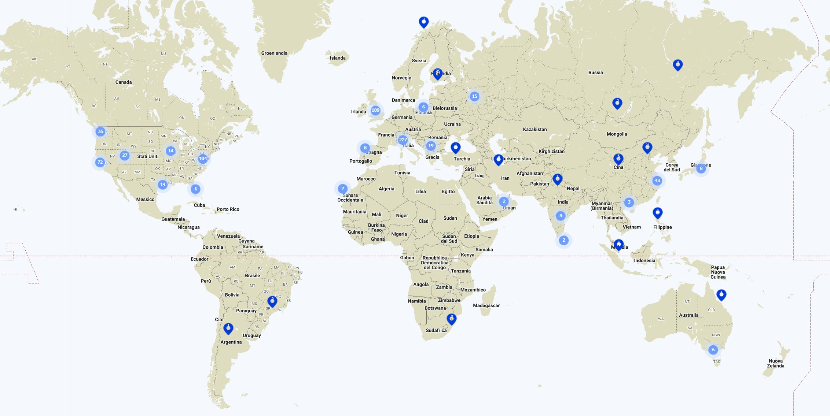
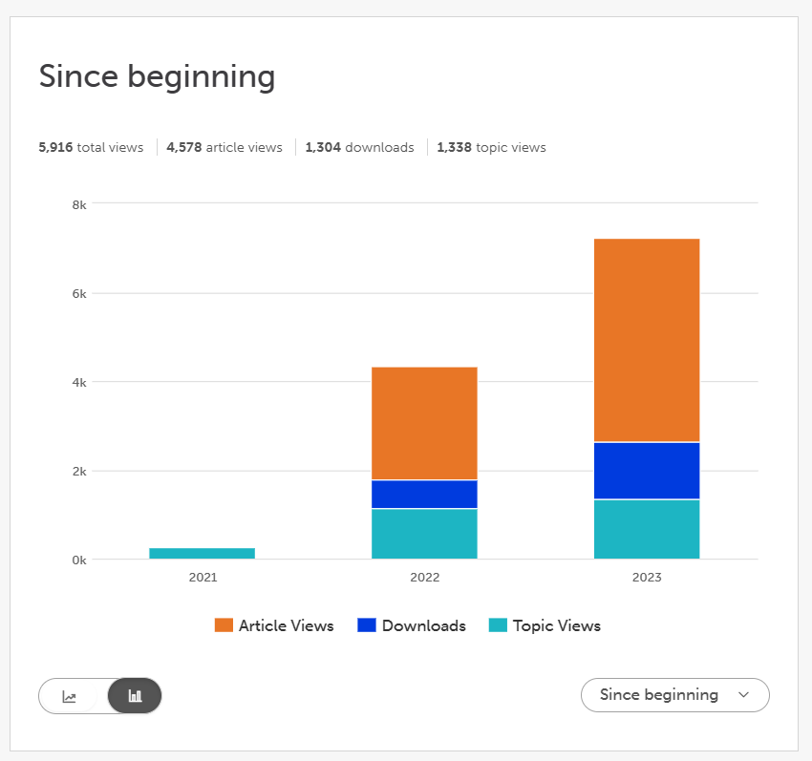
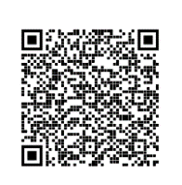
Impact after 2 year
> 7000 views (topic & articles)
> 1000 downloads
> 5 abstracts received
3 published manuscripts
> 30 authors
SCAN the QR CODE
to participate !

