Slide 1

UpDates on Resistive Cylindrical Chambers test
DR. Alessandro Rocchi

Slide 2

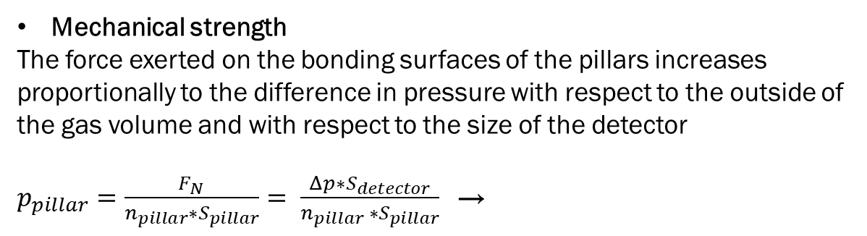

Planar geometry weakness
Mechanical strength
The force exerted on the bonding surfaces of the pillars increases proportionally to the difference in pressure with respect to the outside of the gas volume and with respect to the size of the detector
$p_{pillar}=\frac{F_{N}}{n_{pillar}∗S_{pillar}}= \frac{Δp∗S_{detector}}{n_{pillar} ∗S_{pillar}}$→
F_{N}
$$Δp=2 bar ; S_{detector}=10 kcm^{2} ;$$
$$S_{pillar}=0,2 cm^{2} ;$$
↓
$p_{pillar}=\frac{ {10}^{2}}{n_{pillar} } kbar$
The planar geometry is not suitable to be pressurized unless significantly increasing the density of pillars or building a complex mechanical structure that counterbalances internal forces
F_{N}
The tensile strength of Bakelite is about $1,2 kbar$
Discharge quenching factor
In a uniform electric field, the quenching of the avalanche discharge is mainly due to the gas mixture, the electrode properties and the electric field strength. The geometric factor affects the discharge growth only through the space charge effect.

Slide 3
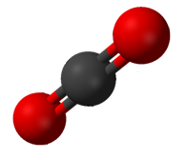

Cylindrical Geometry: Why?
-
The gas pressurization would allow to:
Increase the gas target density, with a consequent increase in intrinsic efficiency
  → MRPC time response with thin single gap configuration
  → light eco-friendly CO₂ based gas mixtures
Use the detector in hostile environments such as space
The electric field gradient, depending on the polarization allows to
Contribute to the gas discharge quenching
  → new eco-friendly gas components
Increase the charge collection efficiency enhancing the multiplication in the initial part of the gas gap
Study the dependencies and optimize the time resolution
Negative polarity
Positive polarity

Slide 4
Aim of the test
-HV
Coaxial
Read-out
The test consists in demonstrating the correct functioning of the device with a quasi-planar cylindrical geometry
Furthermore, consists in characterizing the efficiency, the time response and the shape of the signals in the two polarization conditions. The prototype was designed to emphasize asymmetry, thanks to a non-negligible field gradient.
Under positive polarization conditions, multiplication is expected to occur mainly in the region close to the cathode, which can be described, to a rough approximation by a multiplication followed by drift model.
On the contrary, in negative polarization, multiplication increases as electrons approach the anode, roughly approximating a system characterized by drift followed by multiplication
+HV
Coaxial
Read-out

Slide 5
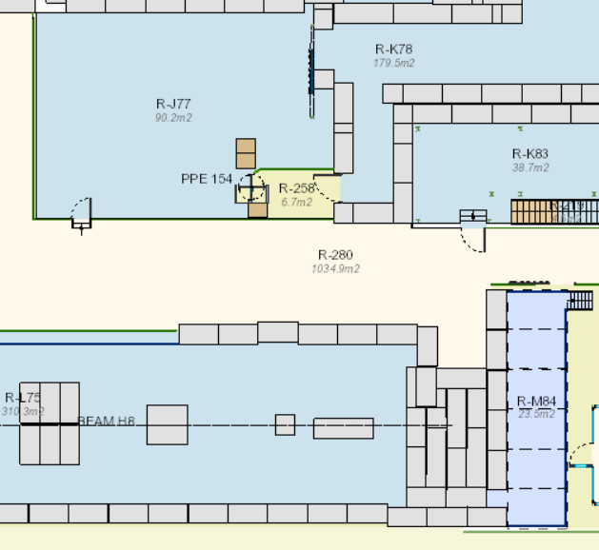
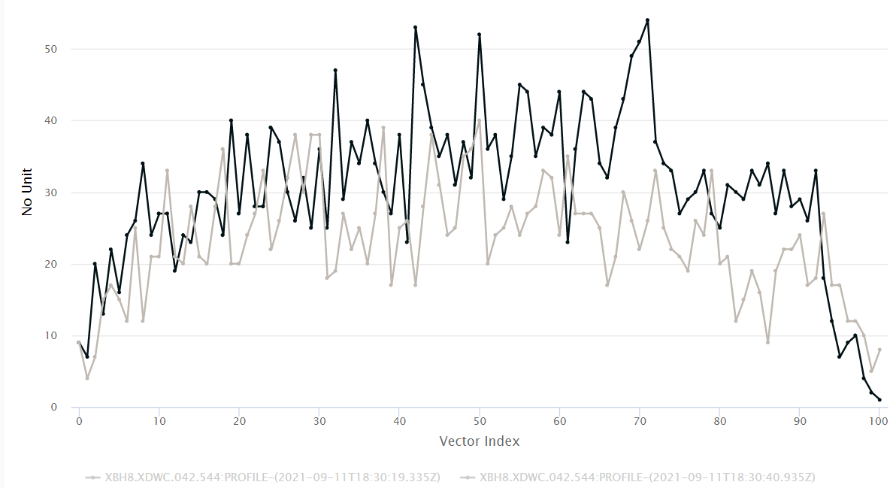
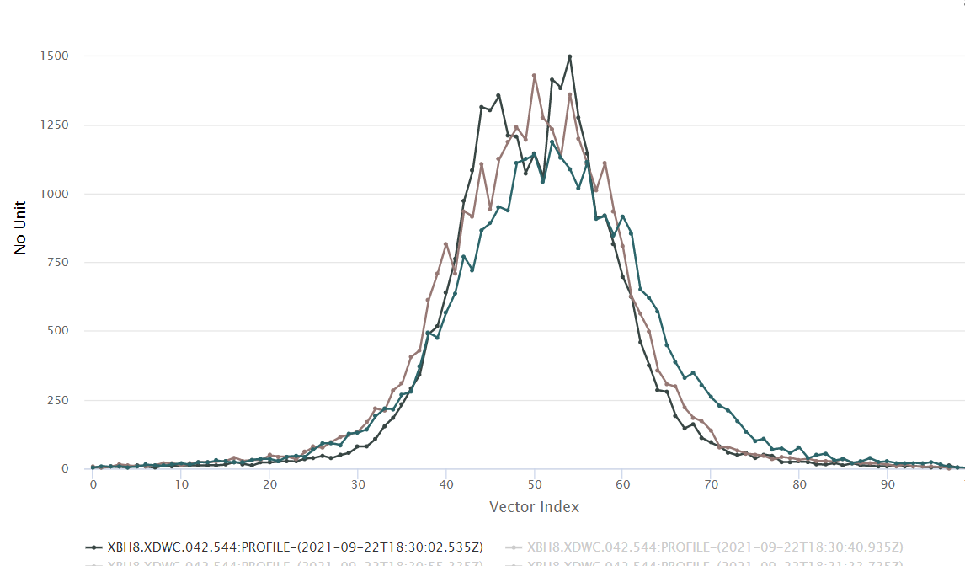


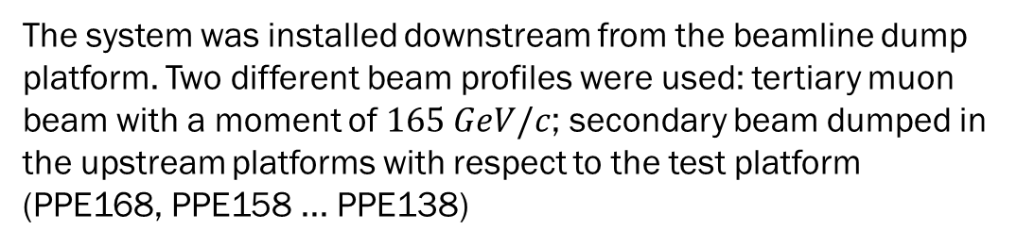
Experimental Facility
The test was carried out at the CERN SPS (H8 beam line), using the beam in parasitic mode.
The system was installed downstream from the beamline dump platform. Two different beam profiles were used: tertiary muon beam with a moment of $165 GeV/c$; secondary beam dumped in the upstream platforms with respect to the test platform (PPE168, PPE158 ... PPE138)
GIF++
Prep. Area
GIF++ Bunker
GIF++ Gas
Gas pipes
H8 beam
Secondary dumped beam profile
Tertiary muon beam profile
H8 line
Beam Dump
Set-up
$$\sim 20 cm$$
$$\sim 4 cm$$

Slide 6
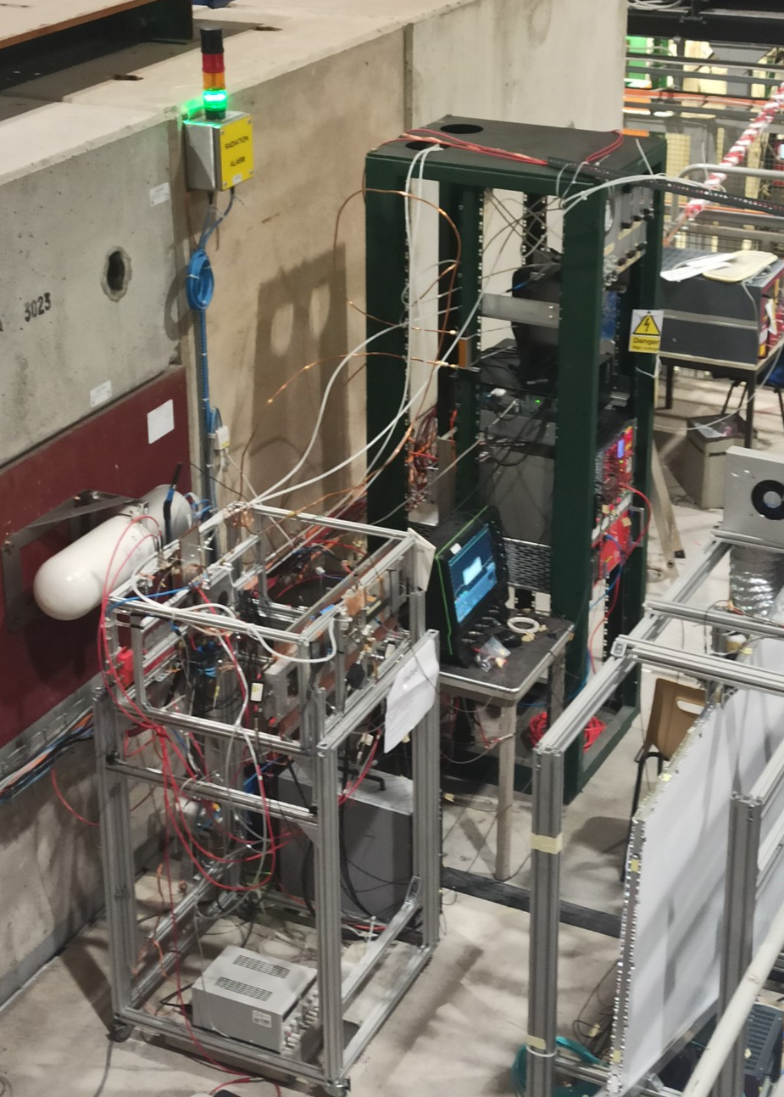
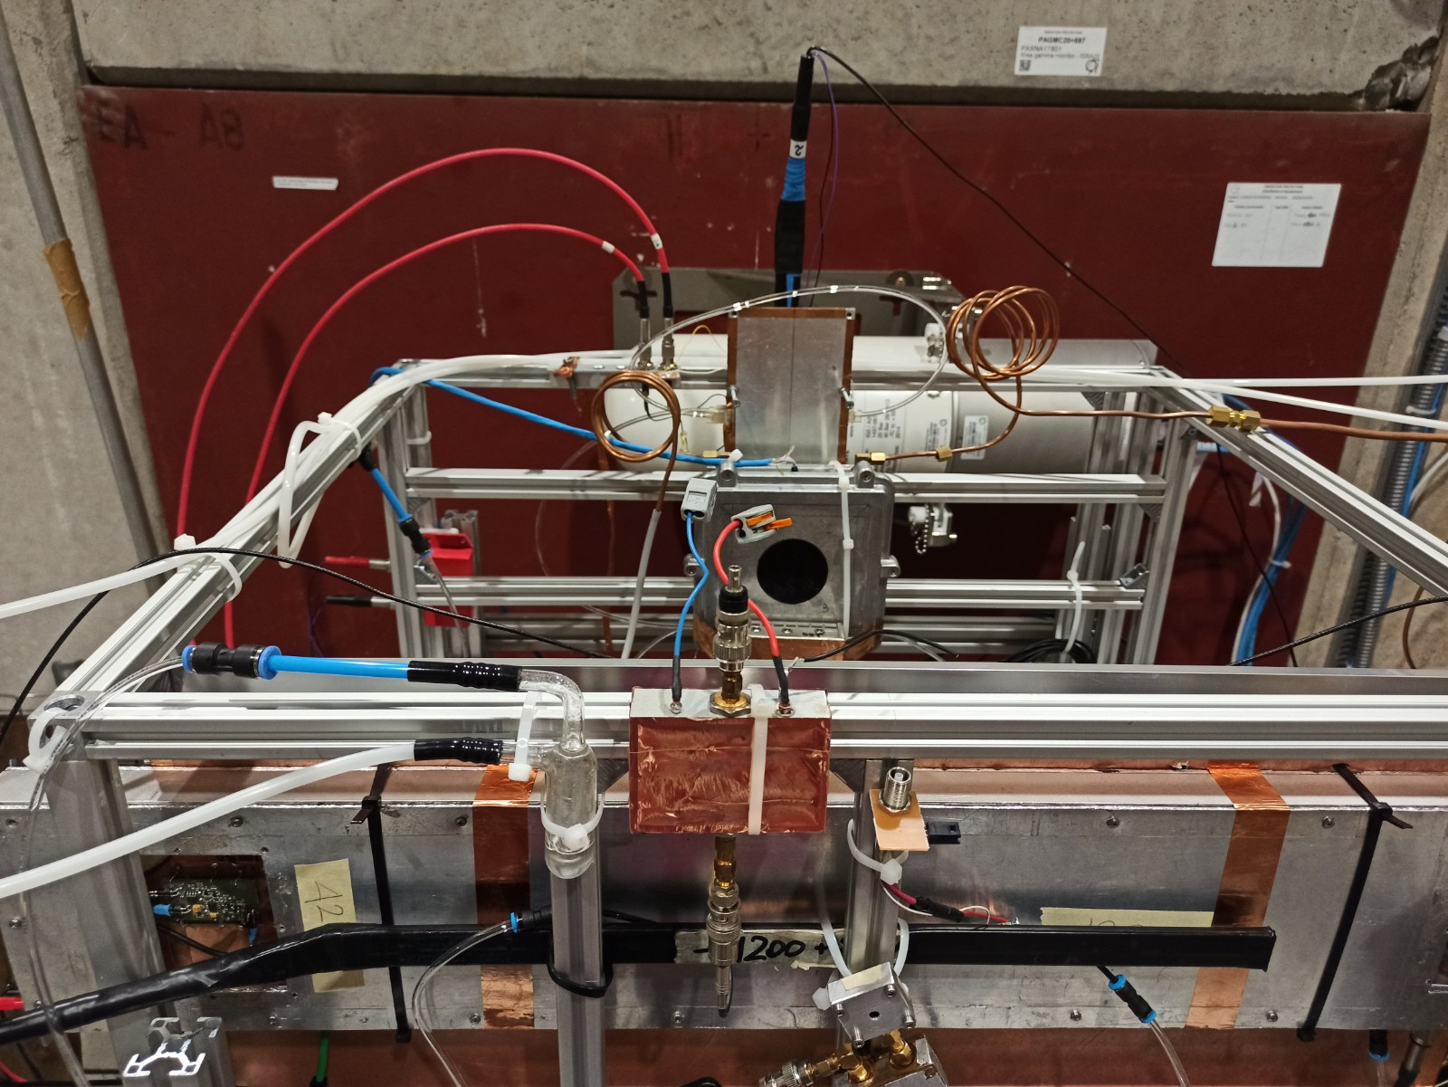
Experimental Set-up
The experimental setup consists of three scintillators used as triggers and other prototypes taken as reference. A UFSD silicon detector was coupled to the RCC to improve acceptance with respect to the trigger, nevertheless, given the small dimensions of the prototypes compared to the profile and the intensity of the beam, a compromise was chosen between geometric acceptance and trigger rate.
The DAQ device is the CAEN V1742 Digitizer (12 bit, 5 GS/s)
Radiation monitor
Resistive
Cylindrical
Chamber
Beam Dump
Setup
RPC 0.2 mm
RPC 0.5 mm
2xScintillators
Prototype 1
Silicon UFSD
Scintillator
Gas mixture: 94.7% TFE + 5% iC4H10+0.3%SF6

Slide 7
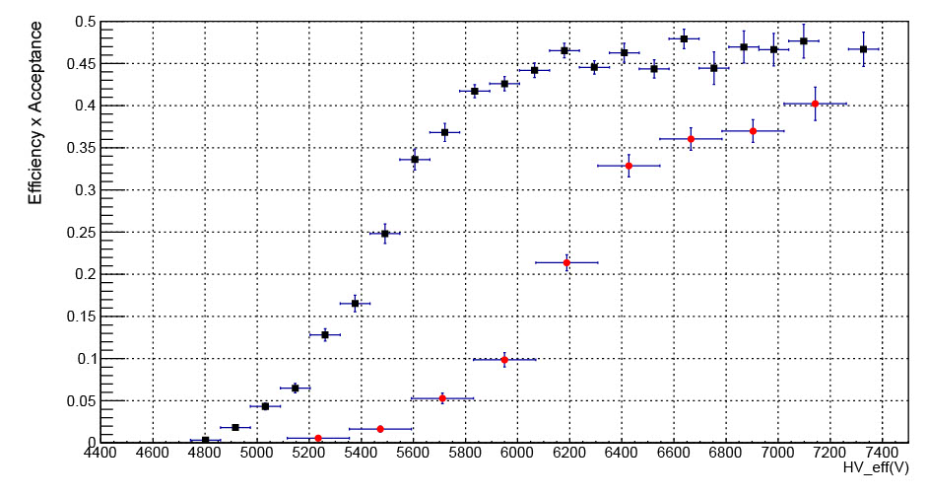


Efficiency
The efficiency was measured using a threshold set at 5 standard deviations from the mean value of the noise pedestal of the digitizer (about 5 mV).
No preamplifier was used in order to preserve the shape of the signal.
In addition to the trigger signal, the coincidence of three other detectors on the beam line was requested offline.
Negative
Positive
The trend of the efficiency curves clearly shows the asymmetrical response of the detector with respect to the bias voltage. In the case of positive bias, in which the multiplication occurs mainly in the first steps, the efficiency knee shifts towards higher voltage values. A reduction in the plateau value is also observed, indicating that the useful gap is thinner than in the case of negative polarization.

Slide 8
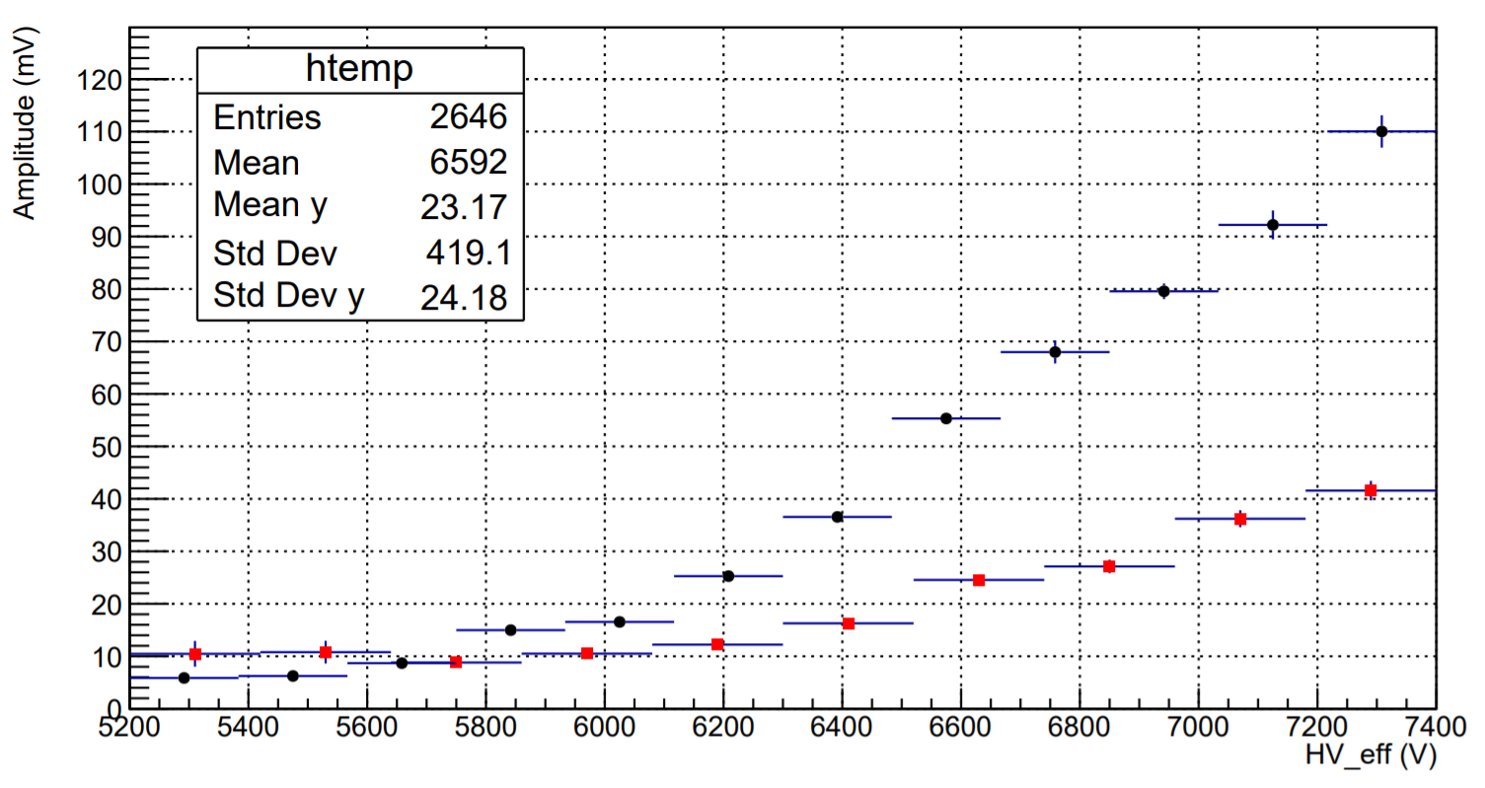
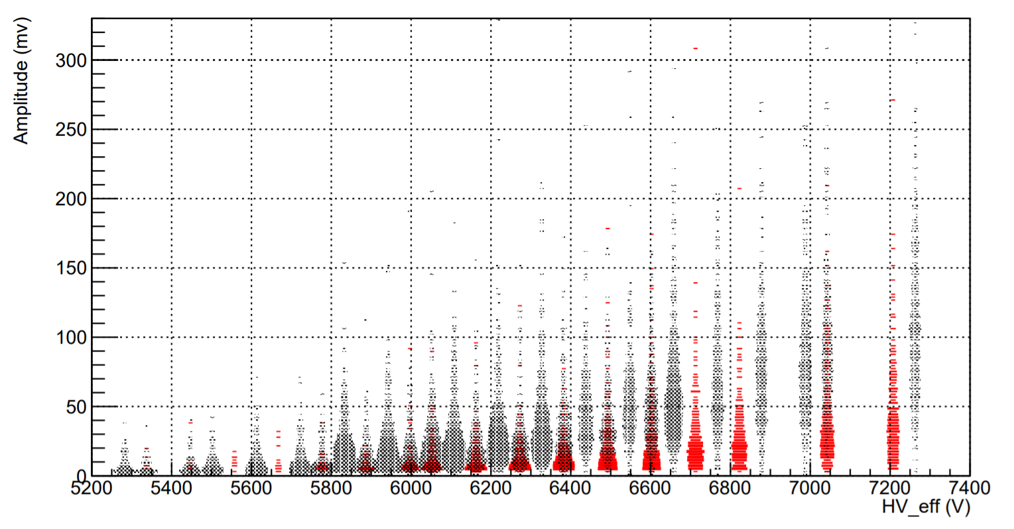
Amplitude distribution
The amplitude distributions of the signals reflect what has been observed in the measurement of efficiency. The signals produced under positive polarization conditions are significantly smaller.
Despite the very large amplitude of the signals, the temporal analysis shows that the working regime is that of a saturated avalanche
Negative
Positive
Negative
Positive

Slide 9
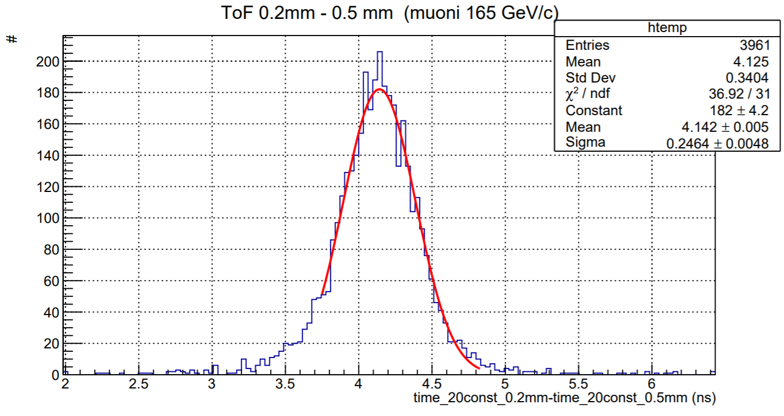
0.2 mm RPC Time Resolution
The time resolution of the double 0.2 mm gap RPC detector was estimated by measuring the time of flight compared to a 0.5 mm gas gap RPC detector.
Total jitter is dominated by fluctuations from the 0.5mm detector.

Slide 10
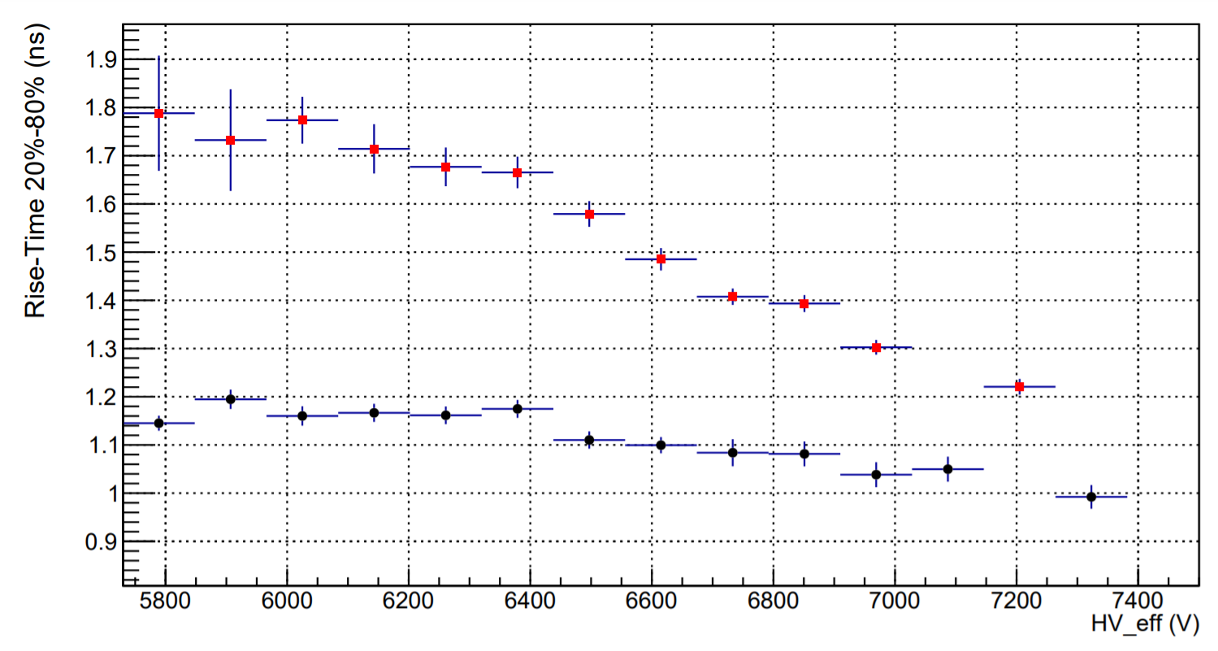
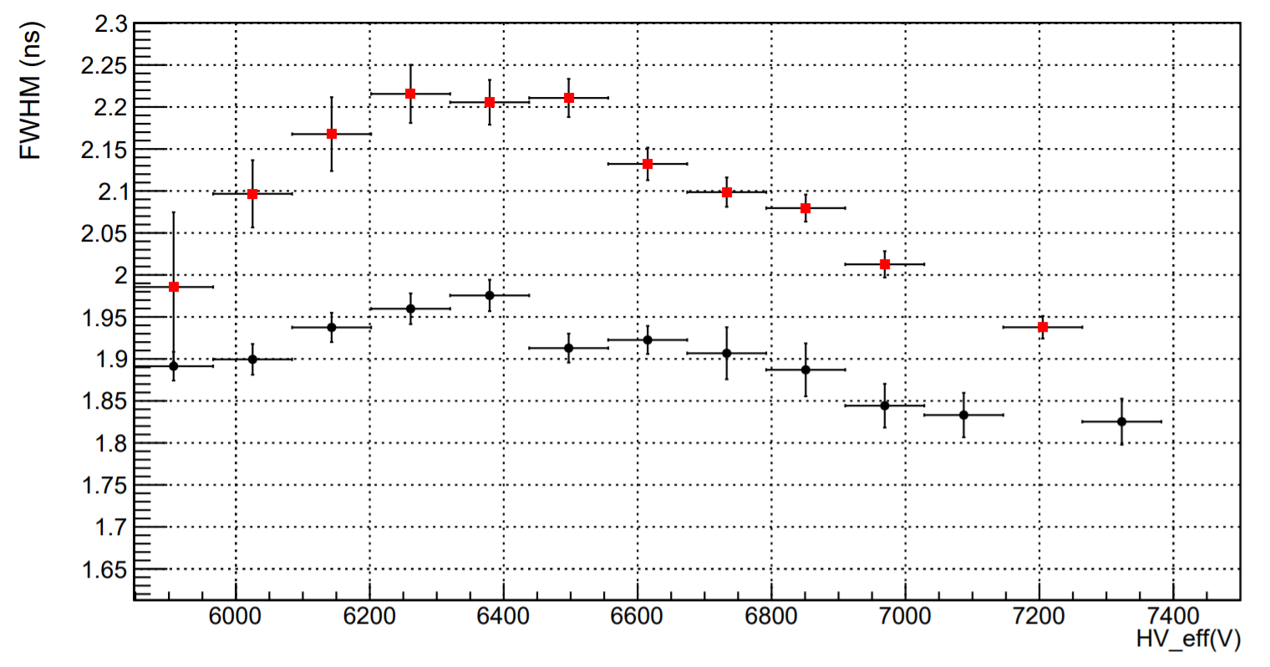
Time response (1)
Negative
Positive
The time response was characterized by measuring the crossing time of some set thresholds. Signals produced in positive polarity conditions are systematically larger. In this condition, the fall time is longer, as expected, meaning that the electrons produced near the cathode give a significant contribution to the signal. The rise time trend is affected by the fact that the signals in negative polarity are significantly higher
Negative
Positive

Slide 11
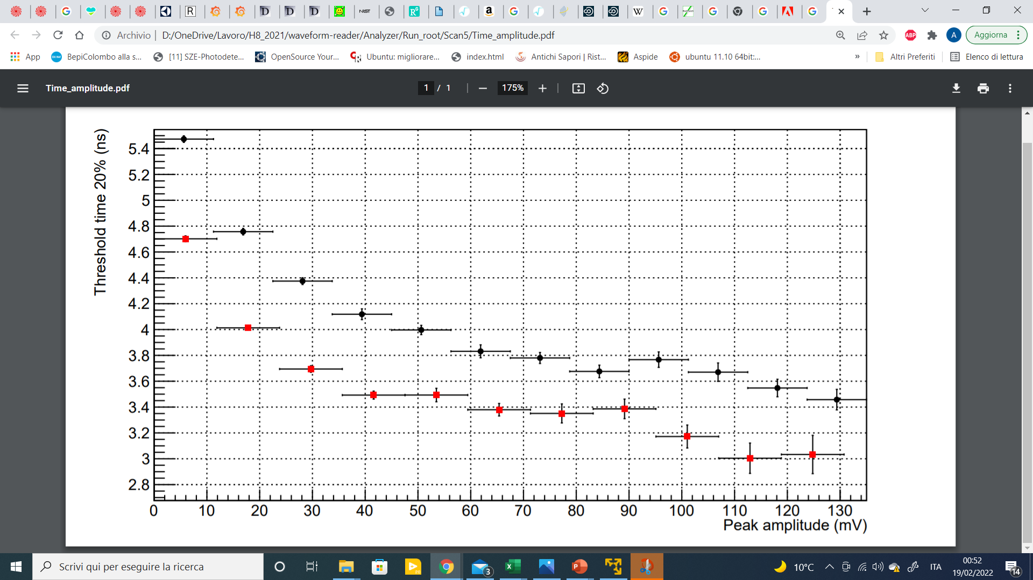
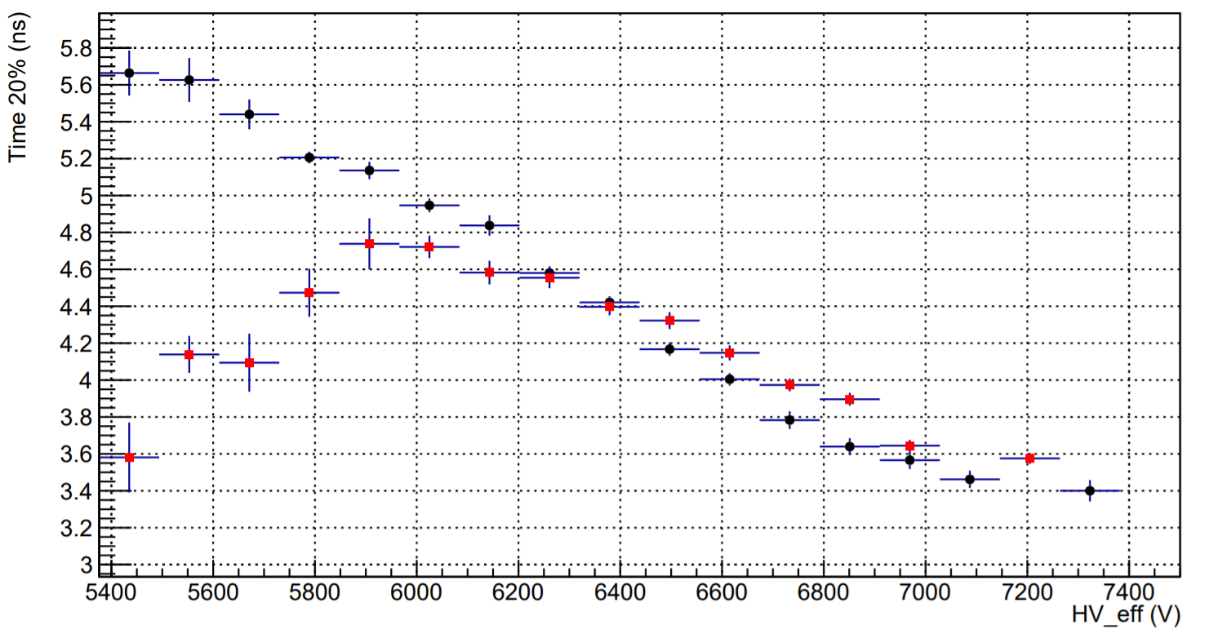
Time response (2)
Negative
Positive
The arrival time was measured using an RPC detector with two coupled 0.2mm gaps as a reference.
Since the amplitude of the signals at fixed voltage is significantly different between the two polarities, the arrival time has been studied as a function of the pulse amplitude.
It can be observed that with the same amplitude, the signals produced in positive polarity systematically anticipate those produced in negative polarity.
Negative
Positive

Slide 12
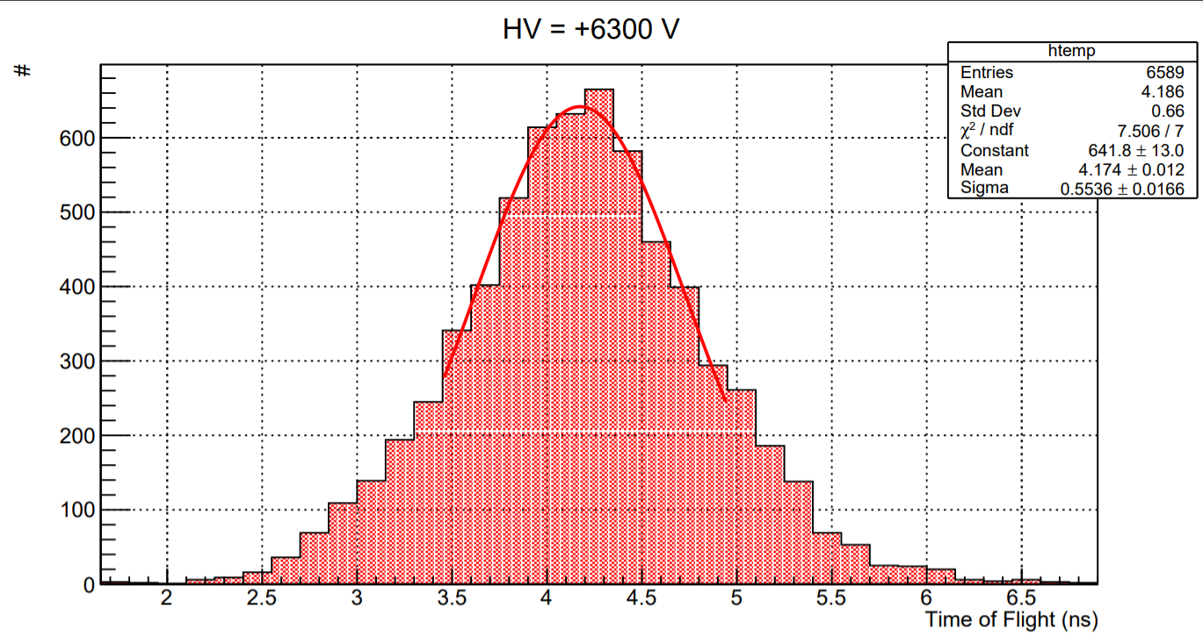
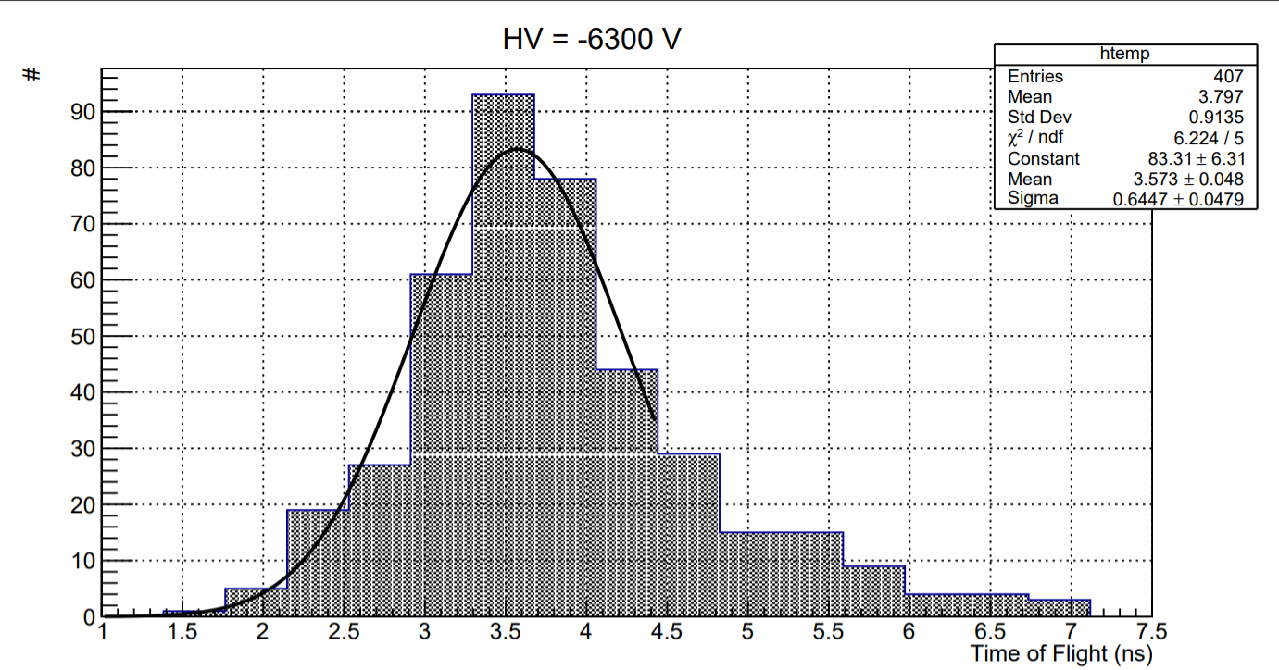
Time resolution
The time resolution was estimated by measuring the time of flight with respect to an RPC detector with 0.2 mm gas-gap whose time resolution is less than 170 ps.
The time resolution improve as the applied voltage increases and for high field values ​​it is systematically better in the case of positive polarization, in which multiplication occurs mainly near the cathode (behavior like that of a thinner gap).

Slide 13
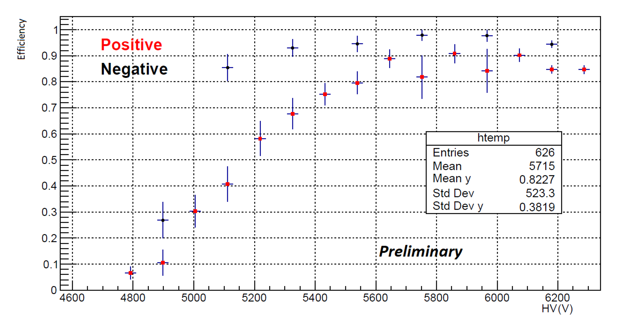
Efficiency with Front-End preamplifier
In this measure the UFSD pixel detector was used to optimize geometric acceptance at the expense of statistics .
A Front-end preamplifier with 1 GHz bandwidth and 50 Ohm input impedance has been used.
With the front-end electronics, even the configuration in positive polarity reaches excellent performance levels

Slide 14
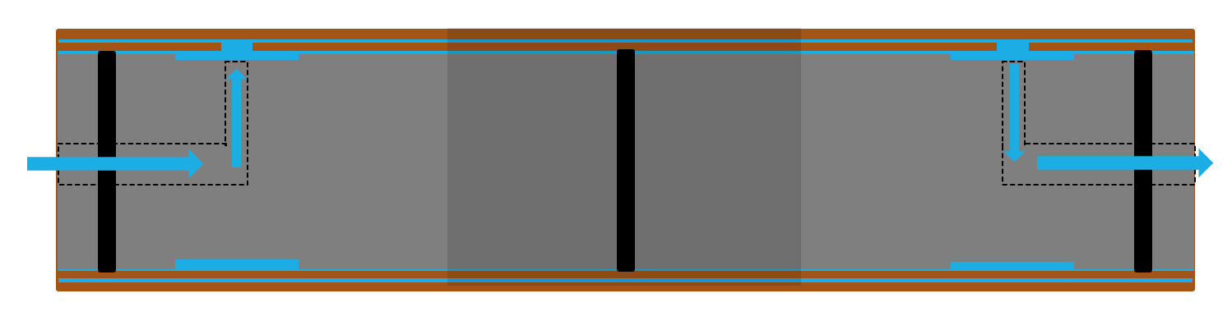
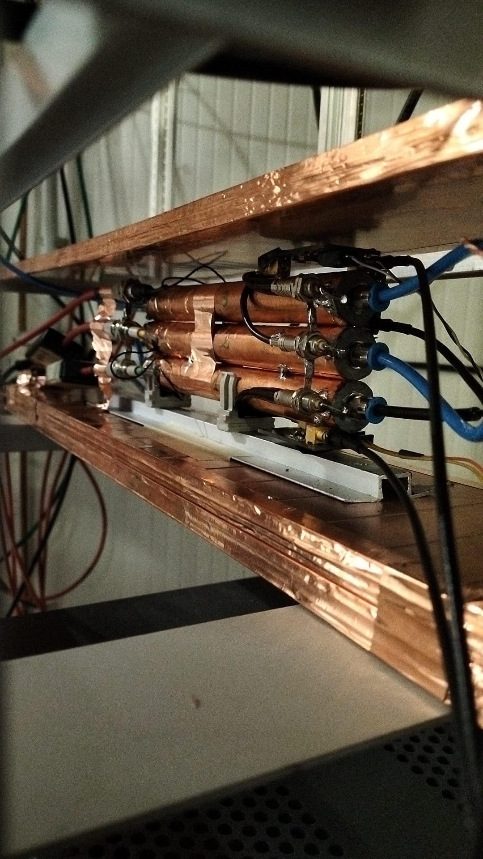
Test in progress
Efficiency;
Time resolution;
CO2 response
D=16 mm
Gap= 0.3 mm

Slide 15
Detectors under construction
three identical pairs of detectors with 0.3 mm gas gap and different radius of curvature
D1=18
D2=16
D3=8

Slide 16
Conclusions
The correct operation of a cylindrical geometry device with a quasi-uniform electric field, operated by fluxing the same gas mixture used for the RPC detectors of the ATLAS experiment, has been demonstrated.
All the measured quantities highlighted the asymmetry of the response with respect to the polarity of the supply voltage, highlighting how the electric field gradient affect the development of the avalanche discharge in the gas
This test represents the first step towards the development of cylindrical geometry detectors with a calibrated field for the intended purpose
Further investigations are necessary to fully understand the link between the temporal evolution of the signal and the electric field

